Slide 1
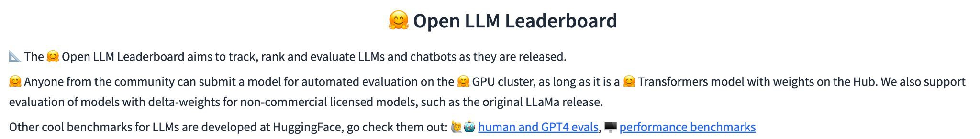
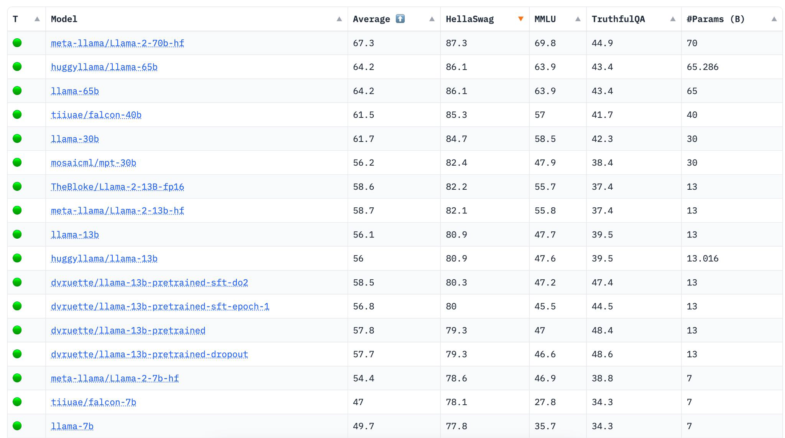

OSS LLMs are getting better everyday
Constant development
Supported by community and industry
Rapid innovation cycle
©2023 Databricks Inc. — All rights reserved
Source: Hugginface.co

Slide 2
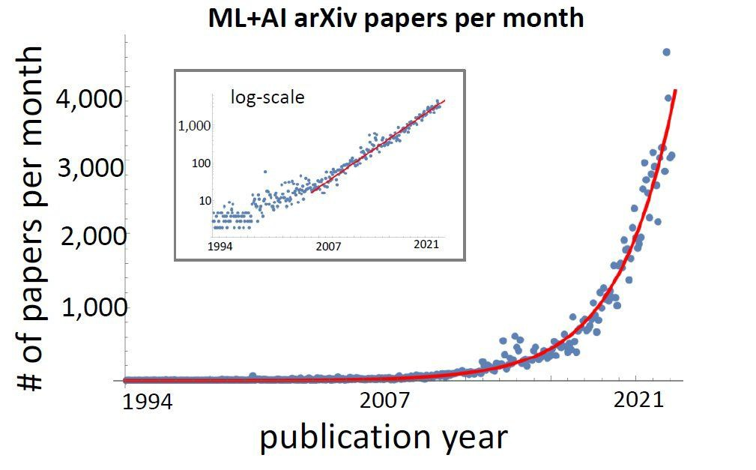
“A strong foundation… is all you need”
What and who this course is for
Research and innovation has exploded around LLMs.
If you want to keep up:
The fundamentals of LLMs have not changed since 2018
Most of the innovation are variations of the original.
Source: Reddit

Slide 3
Enjoy the course!

Slide 4
Course Outline
Course Introduction
Module 1 - Transformers: Attention and the Transformer Architecture Module 2 - Parameter Efﬁcient Fine-Tuning: Doing more with less Module 3 - Deployment Optimizations: Improving model size and speed Module 4 - Multi-modal LLMs: Beyond text-based transformers

Slide 5
Module 1 Transformers
Attention and the Transformer Architecture

Slide 6
Learning Objectives
By the end of this module you will:
Describe and build the inner workings of a transformer model
Compare and contrast the different types of transformer architectures
Recognize the importance and mechanics of attention
Apply the different types of transformer models to solve problems

Slide 7
A Transformative Technology
A breakthrough in Natural Language Processing

Slide 8


Let’s Chat
A new technology paradigm has arrived.
Less than a year old, ChatGPT is the fastest adopted technology in human history.
LLMs like ChatGPT have ushered in a new golden era of AI.
Source: Brookings

Slide 9
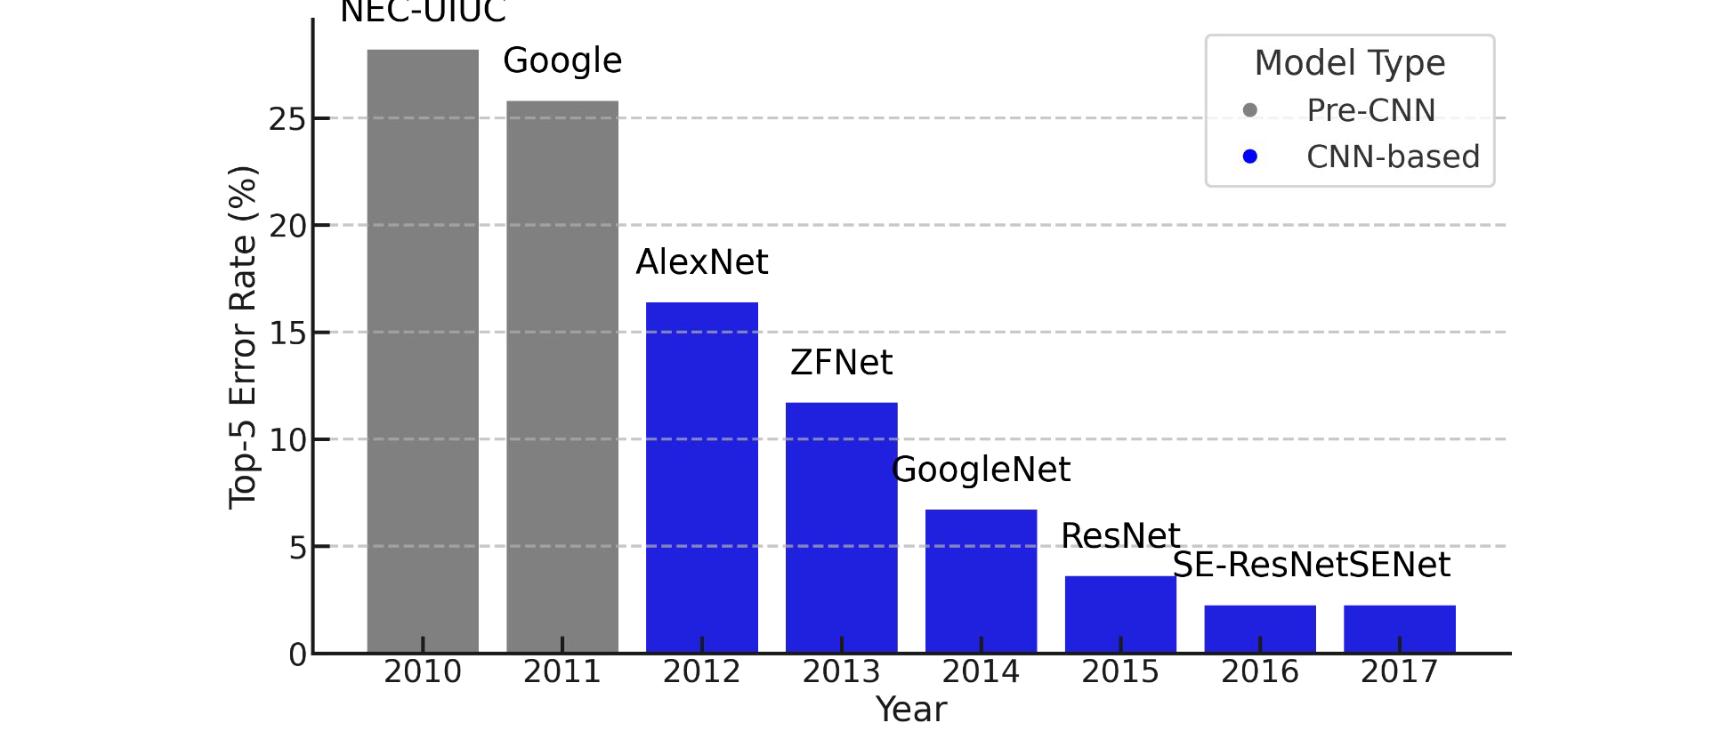

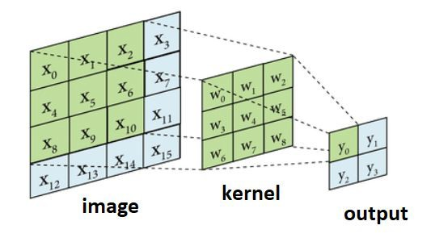
We’ve seen this before
The Convolution Layer led to models that dominated the vision ﬁeld
NEC-UIUC
Source: ResearchGate

Slide 10
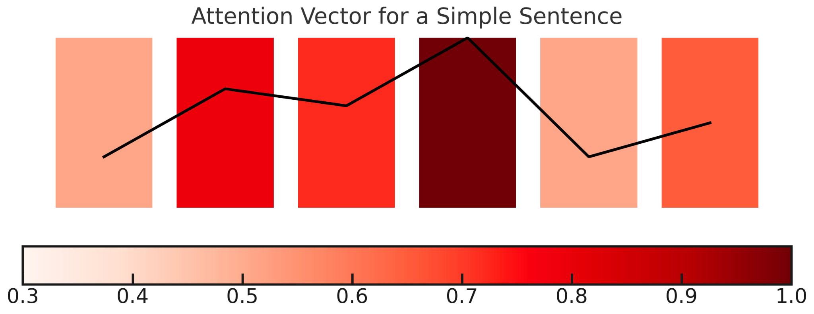
We weren’t paying attention before
Attention: “the convolution layer of language”
The attention mechanism measures how words interrelate
The
cat
sat
on
the
mat

Slide 11
Attention is (not) all you need
A new type of deep learning architecture
Input token embedding vector
Attention is a linear, matrix operation.
Attention
Where is the neural network?
Fully Connected Neural Network
Let’s look at The Transformer Block
Normalization and Residual Connection
Output vector

Slide 12
The Transformer Block
Building up the most important AI advancement in years

Slide 13
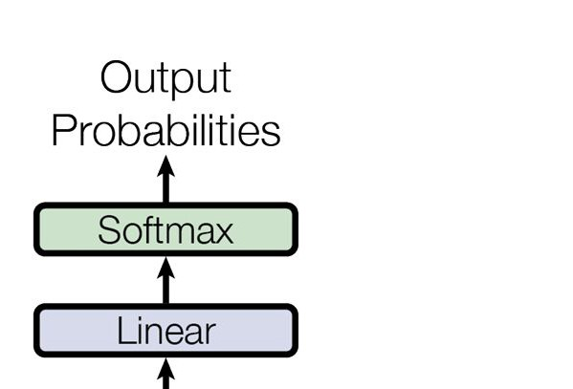
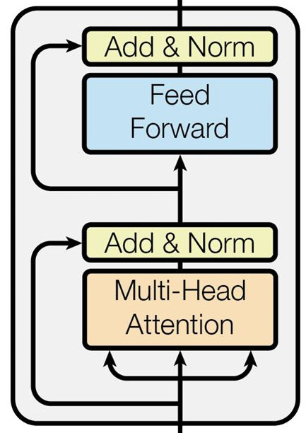
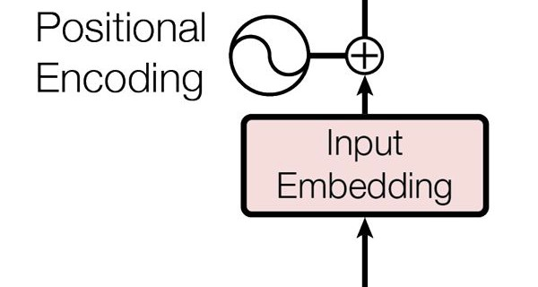
Transforming a sequence
What is the goal of a transformer block?
Transformer blocks:
Output Token Selection
Process input vectors with attention to enrich
Add nonlinear transformation with NN
Apply enriched vectors to select the correct token from the model’s vocabulary
Prediction
Transformer block
Enrichment
Preparation
Input Token Vector
©2023 Databricks Inc. — All rights reserved
*Image modiﬁed from original transformer paper.
Source: ArXiv

Slide 14
Attention Mechanism
How important is each word to each other?
Output Token Selection
The role of
is to:
attention
Measure the importance and relevance of each word relative to each other
Allow for the building-up of enriched vectors with more context and logic
Input Token Vector

Slide 15
Position-wise Feed-Forward Networks
Adding nonlinearity to understanding the input.
(FFN):
Output Token Selection
The role of
Position-wise Feed-Forward Network
is to:
Use the information gathered from the attention stage for each element in the sequence and translate it to a further enriched state
Allow for nonlinear transformations of each element in the sequence and builds upon itself in subsequent layers
Input Token Vector

Slide 16
Residual Connections & Layer Normalization
Ensuring robust and reliable training.
Output Token Selection
Residual Connections
Shortcuts in the network that allow information to ﬂow directly from earlier layers to later layers.
Help mitigate the vanishing gradient problem in deep neural networks.
Layer Normalization
Normalizes the inputs across the features rather than the batch.
Stabilizes the network's training, ensuring consistent input distribution, crucial in tasks with varying sequence lengths.
Input Token Vector

Slide 17
Into and out of the transformer
Input transformations and output transformations
Output Token Selection
Input Token Vector
Output from the Transformer
Exiting the last Transformer block, is a sequence of context-aware vectors.
Each vector in this sequence represents an input token, but now its representation is deeply inﬂuenced by its interactions with all other tokens in the sequence.
Different models use the output from the transformer differently.
Input to the Transformer
The initial input to a Transformer model is a sequence of word tokens.
These tokens are converted into word embeddings.
Positional encodings are added to these embeddings, providing the model with necessary positional information.
This new sequence, with each element a dense vector, is then passed to the ﬁrst transformer block.
©2023 Databricks Inc. — All rights reserved

Slide 18
Transformer Architectures
“Encoders, decoders, T5, oh my!”
©2023 Databricks Inc. — All rights reserved

Slide 19
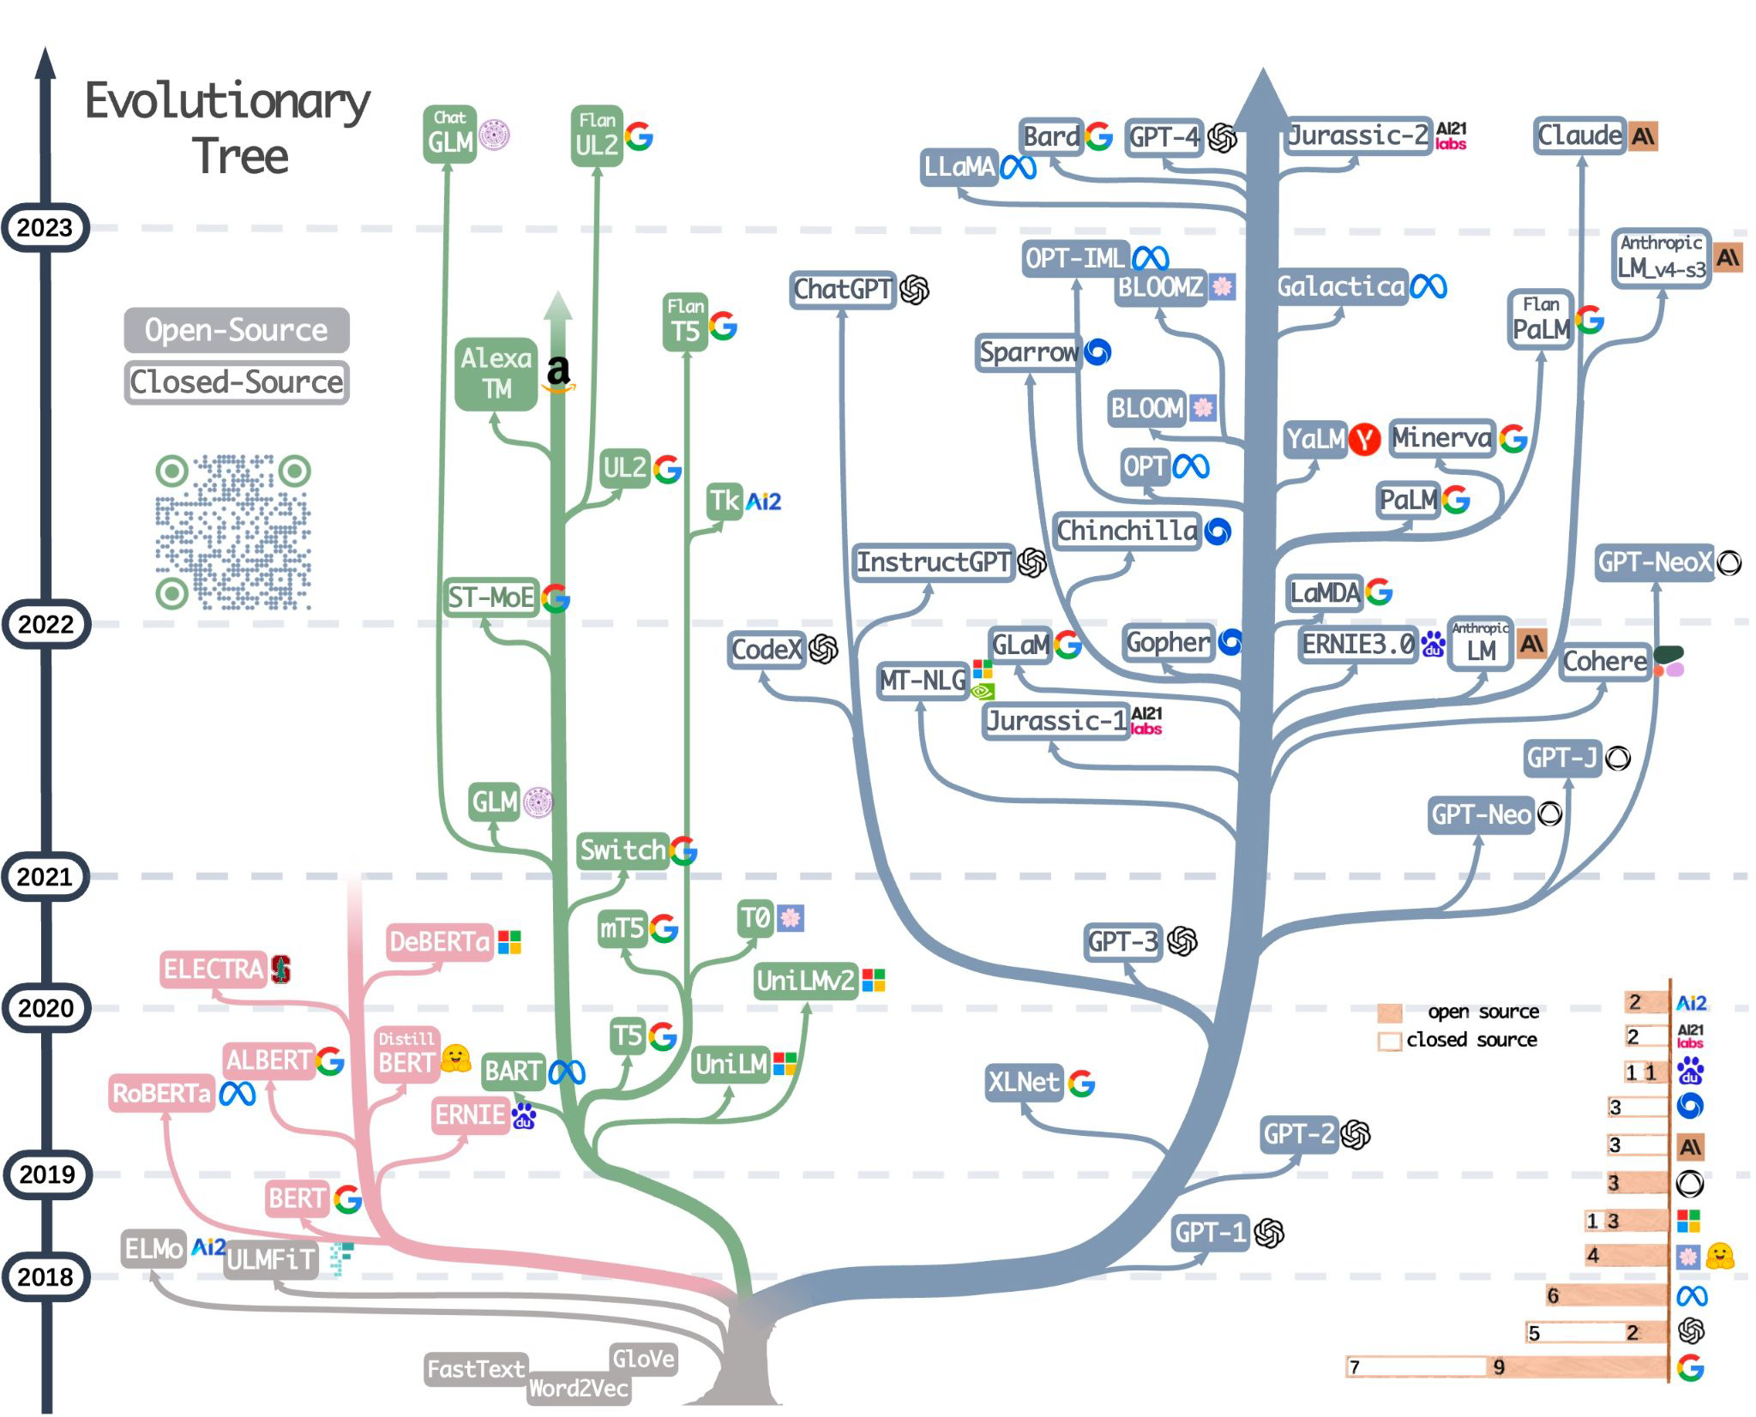


The Transformer Family Tree
Encoder-Decoder
Models
Decoder-only Models
Encoder-only Models
©2023 Databricks Inc. — All rights reserved
Source: GitHub

Slide 20

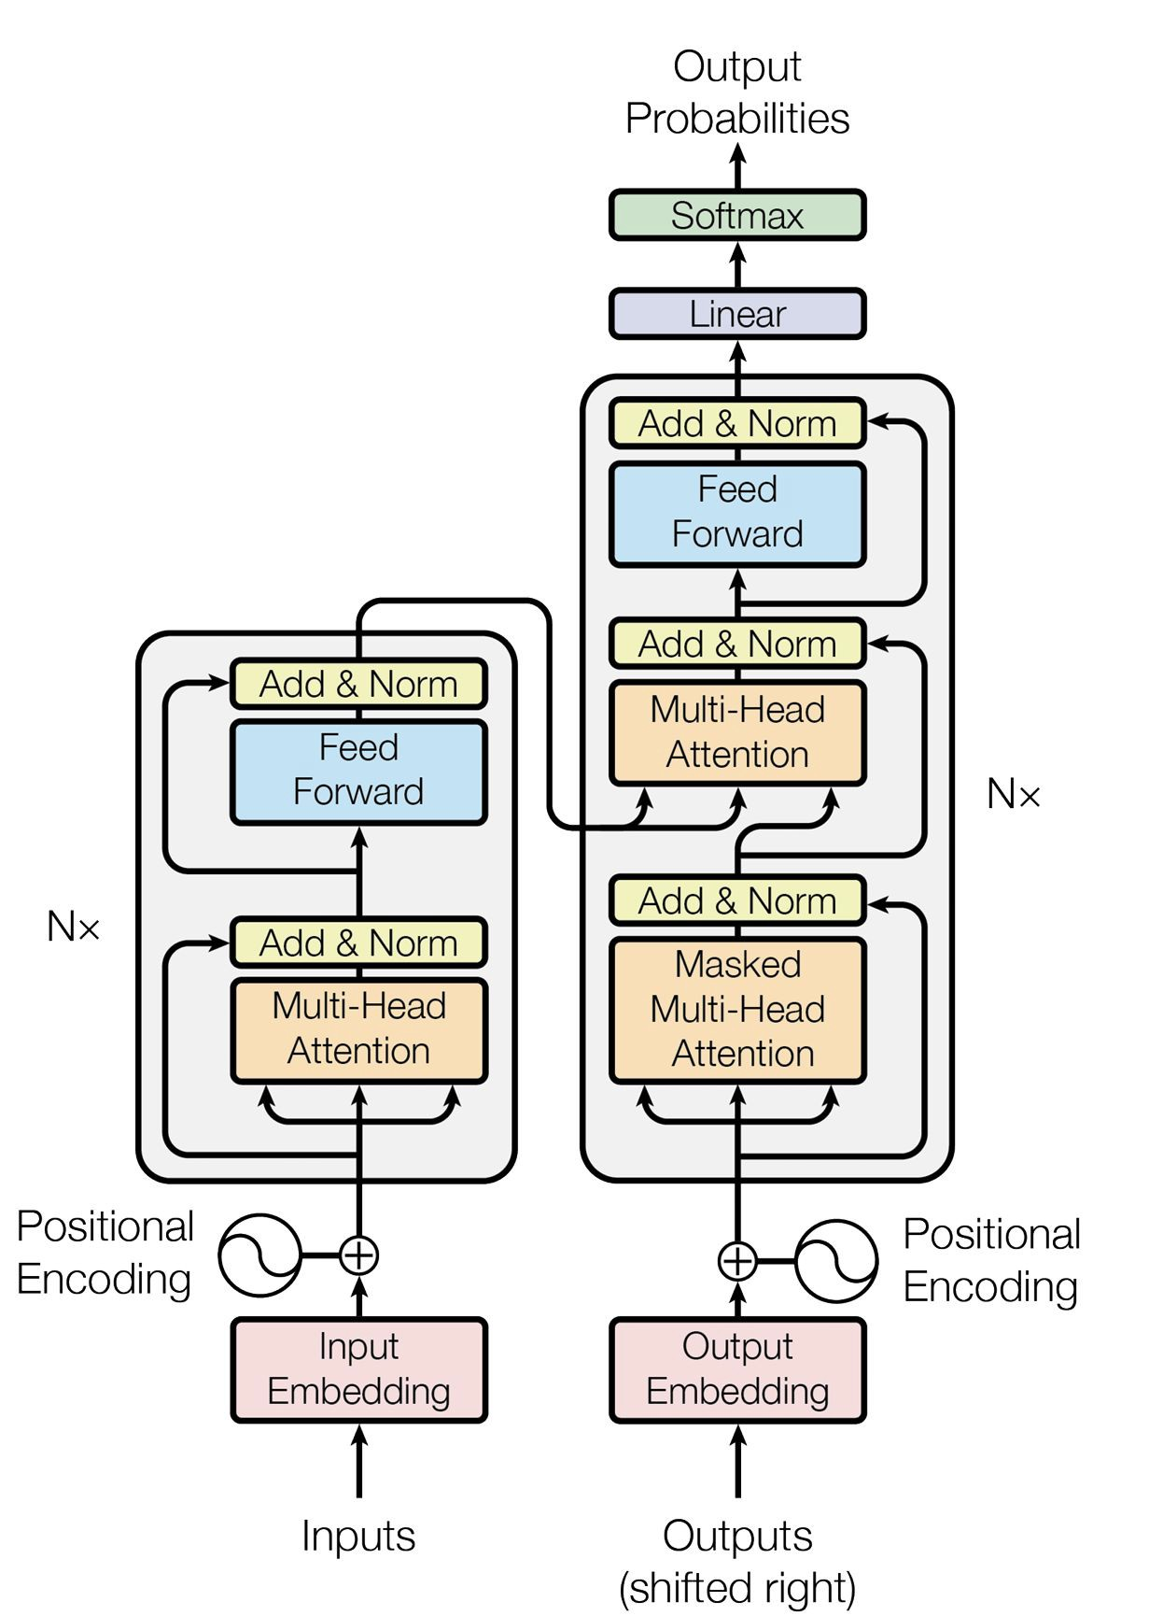
The Original Transformer
An encoder-decoder model
Deﬁning Features:
Two sets of transformer blocks
Encoder blocks
Decoder blocks
Cross-attention
Typical Uses:
Translation
Conversion
Source: ArXiv
©2023 Databricks Inc. — All rights reserved

Slide 21

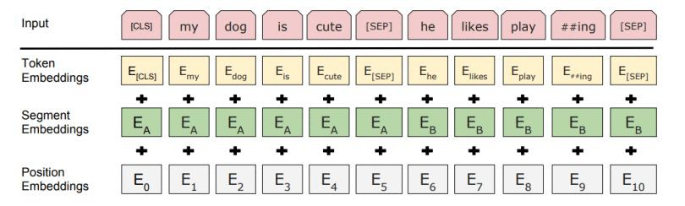

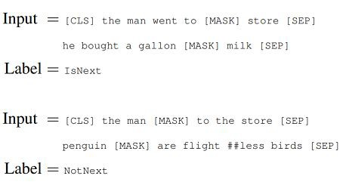

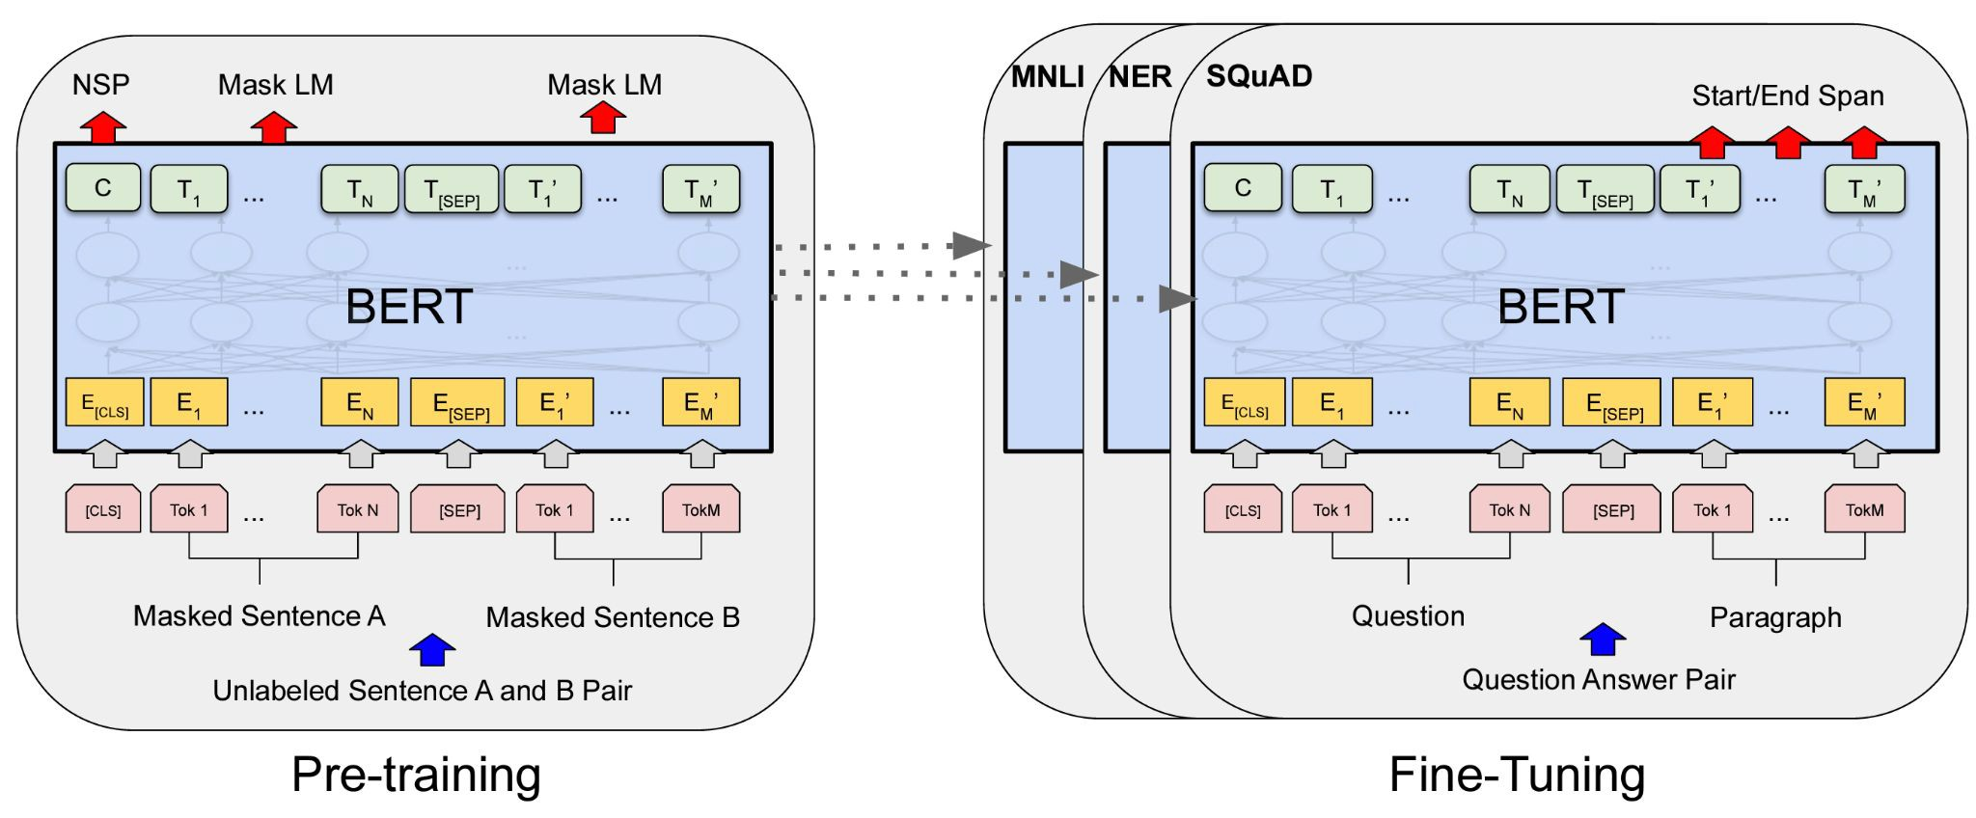
B is for BERT
Encoder-only models
Novel Features of BERT:
Segment embeddings ([CLS] and [SEP] special tokens)
Trained with Masked Language Modeling & Next Sentence Prediction
Excellent Fine-Tuning Performance
©2023 Databricks Inc. — All rights reserved
Source: ArXiv

Slide 22

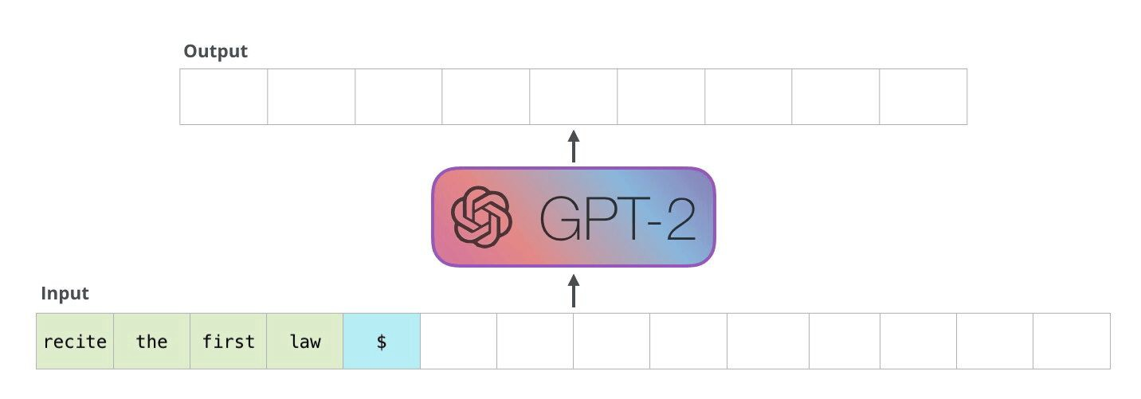
Generating text with GPT
Decoder-only models
Decoder models have a single task:
Look over the sequence and predict the next word (or token).
Decoder models products: ChatGPT, Bard, Claude, LLaMA, MPT
Source: IllustratedTransformer

Slide 23
Important variables in Transformers
Input
Internal
Number of Attention Heads
Training
Batch Size (B):
Vocabulary Size (V):
The number of unique tokens that the model recognizes.
(H):
In the multi-head attention mechanism, the input is divided into H different parts.
The number of examples processed together in one forward/backward pass during training.
Embedding/Model Size (D): The dimensionality of the word embeddings, also known as the hidden size.
Intermediate Size (I):
The feed-forward network has an intermediate layer whose size is typically larger than the embedding size.
Tokens Trained on (T):
The total number of tokens that a model sees during training. This is normally reported more than the number of epochs.
Sequence/Context Length (L): The maximum number of tokens that the model can process in a single pass.
Number of Layers (N):
The number of Transformer blocks/layers.

Slide 24
Time to Pay Attention
The secret that unlocked the power of LLMs

Slide 25
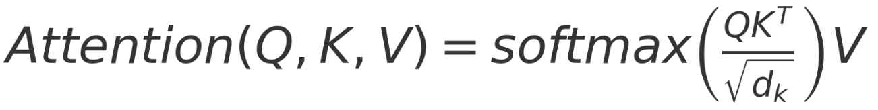
The inner workings of attention
Learning the weights of attention.
We use three, large (millions of elements), matrices to create the Query, Key, and Value vectors in each layer.
Query Matrix: W_{Q}, Key Matrix: W_{K}, Value Matrix: W_{V}
W_{Q}
Query Vector
Word Vector
The Attention equation can be expressed as an operation over all the vectors:

Slide 26
The inner workings of attention
How do we calculate attention?
Word+Position Embedding Vector
The mechanism can be broken down into three steps:
Query Vector
The input vector (in the ﬁrst layer, this is the word embedding vector (with the position information), is used to create three new vectors:
the Query (Q) vector - made from the current token
the Key (K) vector - made from all other tokens in the sequence
the Value (V) vector - made from all tokens in the sequence
A scaled dot-product is then performed on the Query and Key vectors, this is the attention score. This also uses a softmax function to produce a ﬁnal set of Attention Weights that are scaled 0-1.
Key Vector
Value Vector
Key Vector… Key Vector 3
Key Vector 2
Key Vector 1
Query Vector
Attention Weights
3) Each Value vector is multiplied by its corresponding attention weight and then all are summed up to generate the output for the self-attention layer.
Attention Weights
Value Vector
Element-wise multiplication
Output Vector

Slide 27
Building Base/Foundation Models
Training transformers, what does it take?

Slide 28
Foundation Model Training - Getting Started
Choosing the right options to build your model.
A foundation, or base, model is a transformer that is trained from scratch.
Model Architecture - decoder? encoder-decoder?
Tailored to the task/problem
Different sizes: embedding dimensions, number of transformer blocks, etc.
Available Data
Task-relevant data
Good language coverage
Available Compute Resources
Time to allow for training
Hardware available

Slide 29
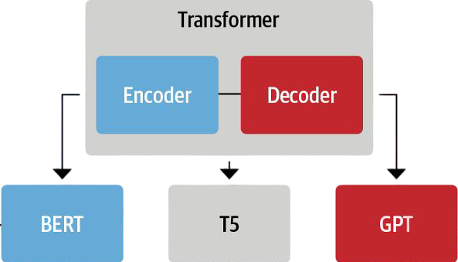
Foundation Model Training - Architecture
Which transformer ﬂavor is right?
Start with your task:
Classiﬁcation?
Generation?
Translation?
Architecture:
Layer count
Context size
Autoencoding models
Sequence-to-sequence models
Autoregressive models
Source: GitHub

Slide 30

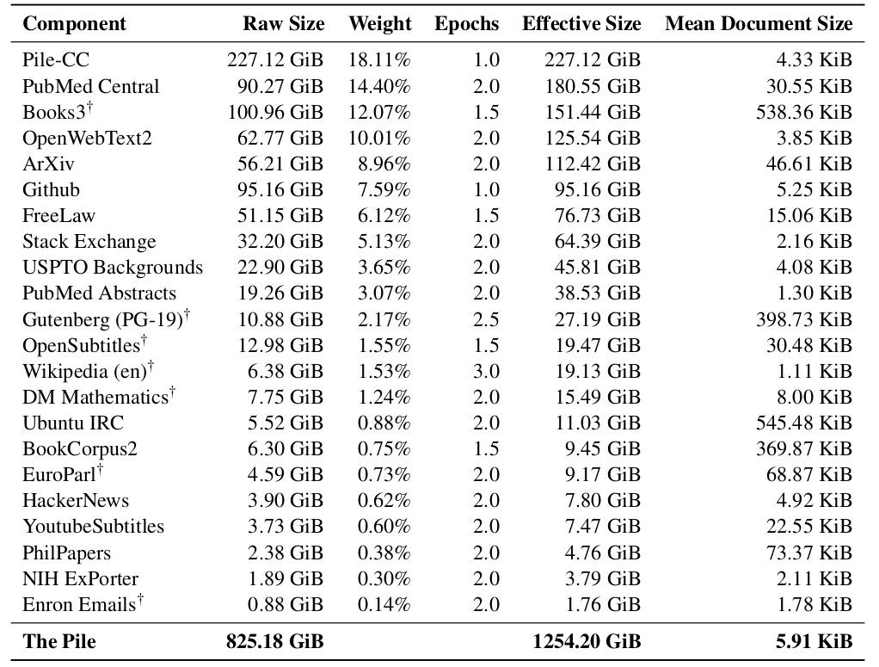
Foundation Model Training - Data
It’s all about the data
Datasets for foundation LLM:
Web Text
Code
Images
Digitized Text
Transcriptions
Source: Stanford CS324

Slide 31
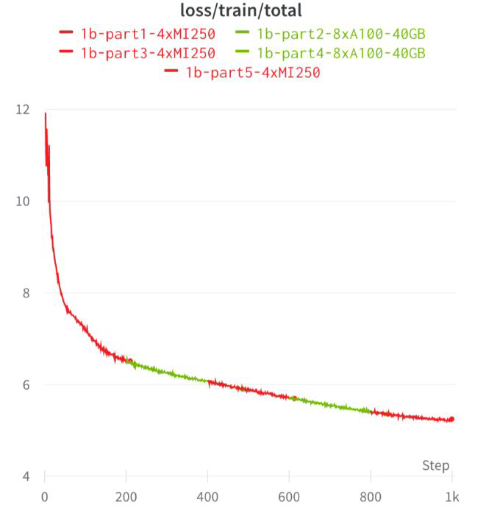
Foundation Model Training - Training
Optimizing LLM Losses
LLMs train just like other deep learning models.
Loss functions are typically cross-entropy.
Familiar optimizers like AdamW, are used.
Training LLMs with 100’s of billions of parameters, can take months on hundreds of GPUs.
Source: MosaicML

Slide 32
Now what?
What do you use a foundation LLM for?
Foundation LLMs suffer from “alignment” problems:
Bias/toxicity in the training data
Lack of speciﬁc task focus -> for models like GPT it just focuses on selected the next correct word
Fine tuning and other methods are required to ensure task success.

Slide 33
Generative Pretrained Transformer
A journey to discover how GPT-4 and ChatGPT were built.

Slide 34
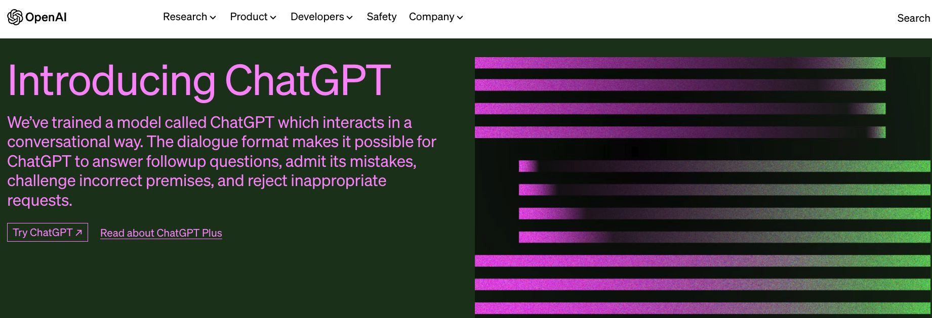
The journey to ChatGPT
What is GPT?
ChatGPT was originally built atop a large language model known as GPT-3.5.
GPT-3.5 is a type of decoder-based transformer model.
Let’s see what exactly GPT is.
Source: OpenAI

Slide 35
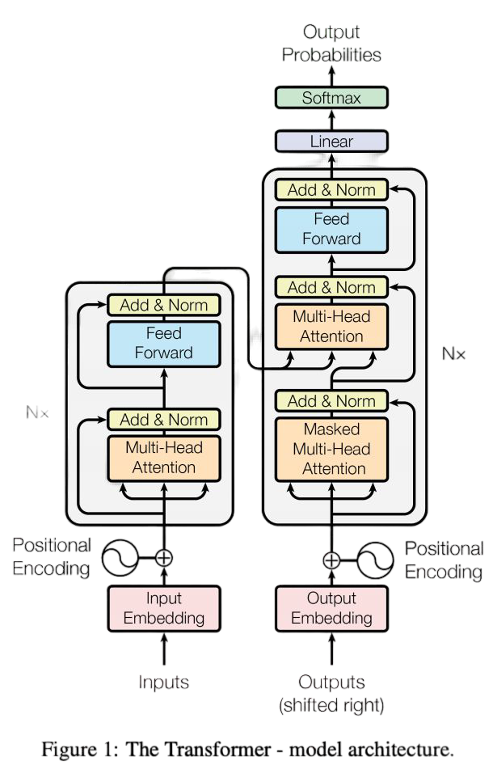

Generative Pre-trained Transformers (GPT)
Decoder-based transformers
The ﬁrst GPT model, introduced in 2018 was just the decoder part of the original transformer.
Decoder Models only use the second half of the original transformer architecture. No cross/encoder attention.
GPT-2/-3/-4 have mostly just been larger versions. With the key differences coming from training data and training processes.
GPT/GPT-1
GPT-2
GPT-3
12 x
48 x
96 x
512 dimension embeddings
1024 dimension embeddings
2048 dimension embeddings
Source: LinkedIn

Slide 36
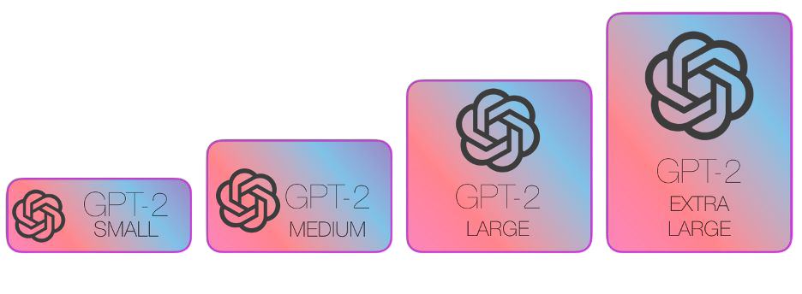
Generative Pre-trained Transformers (GPT)
Generational Improvements
GPT (2018):
It was pre-trained on the BooksCorpus dataset and contained 117 million parameters. GPT was an autoregressive model based on the Transformer architecture and employed a unidirectional language modeling objective.
GPT-2 (2019):
pre-trained on a much larger dataset called WebText, which contained text from web pages with a total of 45 terabytes of data. GPT-2 came in four different sizes: 117M (small), 345M (medium), 774M (large), and 1.5B
(extra-large) parameters.
1,542M Parameters
762M Parameters
345 Parameters
117M Parameters
©2023 Databricks Inc. — All rights reserved
Source: IllustratedGPT2

Slide 37
Generative Pre-trained Transformers (GPT)
Generational Improvements
GPT-3 (2020):
Pre-trained on the WebText2 dataset, an even larger portion of the internet, 45 terabytes of text. GPT-3 came with a staggering 175 billion parameters
Exceptional few-shot and zero-shot learning capabilities, allowing it to perform well on various tasks with minimal or no ﬁne-tuning.
GPT-4 (2023):
Speciﬁc details about the architecture, dataset, and parameter count for GPT-4 have not been ofﬁcially released. Likely ~1T parameters in an ensemble of smaller models of ~220B parameters each.

Slide 38
GPT Architecture

Slide 39
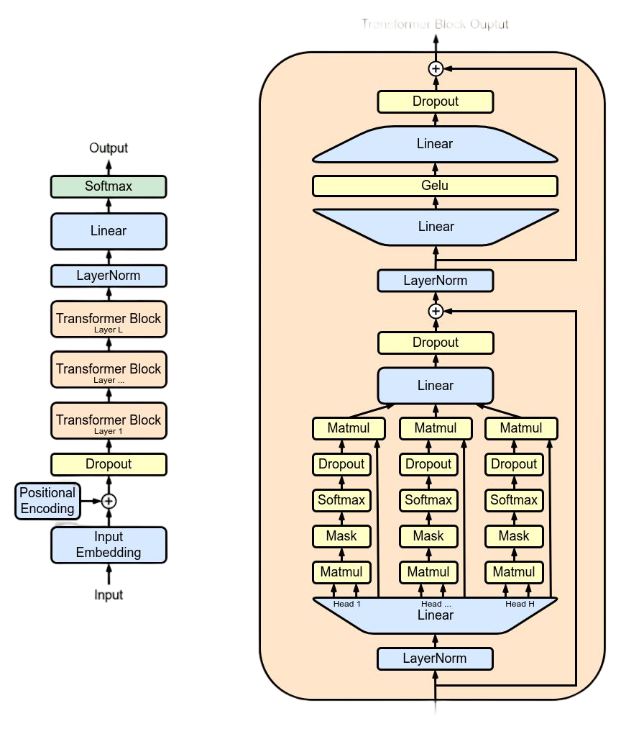
So many layers?
Why GPTs keep getting bigger
Transformer Block Output
The main component of each layer: multi-headed attention block.
Like in convolutional layers, the earlier features that are learned might be edges and lines, and the later layers are more complex visual artifacts, attention layers work in a similar fashion:
Early Attention: short-range dependencies, relationships between adjacent or close tokens.
Word order
Part-of-Speech
Basic sentence structure.
Middle Attention: overall context of the input sequence.
Semantic information.
Meaning.
Relationships between phrases.
Roles of different words within the sentence.
Late Attention: integrates the lower layers and generates coherent and contextual outputs.
High-level abstractions.
Discourse structure.
Sentiment.
Complex long-range dependencies.
Transformer Block Input
Source: Wikipedia

Slide 40
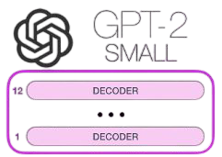
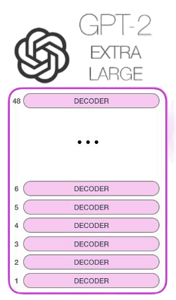
Why so many parameters?
Parameter | GPT-2 Small | GPT-2 Extra Large | Difference Extra Large / Small
Layers | 12 | 48 | 3x
Model Dimensionality | 768 | 1600 | 2x
Attention Heads per Layer | 12 | 25 | 2.5x
Total | 117 Million | 1.5 Billion | 12.8x
117M parameters
1.5B parameters
Source: IllustratedGPT2

Slide 41
Training GPT

Slide 42


Training Data
The magic behind the model
GPT-1: BooksCorpus
Over 7,000 unpublished books spanning various genres.
800 million words, covering a wide range of topics and styles.
GPT-2: WebText
Much larger than BookCorpus
A collection of text from web pages, consists of 45 terabytes of data.
Filtered out web pages with low quality content
GPT-3: WebText2
Even larger than WebText and more diverse
The increased size and diversity of the WebText2 dataset contribute to GPT-3's impressive performance on various NLP tasks.
2.0

Slide 43
Comparing LLM Architectures

Slide 44
BERT vs. GPT vs. T5
Which type of LLM is best?
 | Encoder-only (eg. BERT) | Decoder-only (eg. GPT) | Seq-2-Seq (eg. T5)
Pros | Pre-trained on a masked language modeling task bidirectional context for a deeper understanding of input sequences. Leads to strong feature extraction capabilities. Typically several orders of magnitude smaller than decoder or seq-2-seq model. | Autoregressive nature makes them well-suited for text generation tasks. Can generate coherent and contextually relevant text. | Encoder-decoder architecture allows for better handling of complex, structured input-output relationships. Attention mechanisms help weigh the importance of different parts of the input when generating the output.
Cons | Not ideal for text generation tasks due to their bidirectional nature. Can have higher computational costs compared to decoder-only models. | Only capture unidirectional context (left-to-right), which can limit their contextual understanding. Autoregressive generation can be slow due to sequential token prediction. | Can require more training data and computational resources compared to encoder-only or decoder-only models. Can be more complex to train and ﬁne-tune due to the two-part architecture.

Slide 45

Module Summary
Transformers - What have we learned
Transformers are built from a number of transformer blocks
Transformer blocks use attention and neural networks to enrich vectors
Transformer models can be encoder, decoder, or encoder-decoder
The evolution of GPT required changes in architecture, and in data
Base/Foundation models require ﬁne tuning to solve most tasks

Slide 46
Time for some code!

Slide 47
Course Outline
Course Introduction
Module 1 - Transformers: Attention and the Transformer Architecture Module 2 - Parameter Efﬁcient Fine-Tuning: Doing more with less Module 3 - Deployment Optimizations: Improving model size and speed Module 4 - Multi-modal LLMs: Beyond text-based transformers

Slide 48
Module 2
Efﬁcient Fine-Tuning
Doing more with less

Slide 49
Learning Objectives
By the end of this module you will:
Understand what ﬁne-tuning is and why we do it
Learn what parameter-efﬁcient ﬁne-tuning is and what the popular strategies are
Understand the limitations of parameter-efﬁcient ﬁne-tuning
Gain knowledge about data preparation best practices

Slide 50
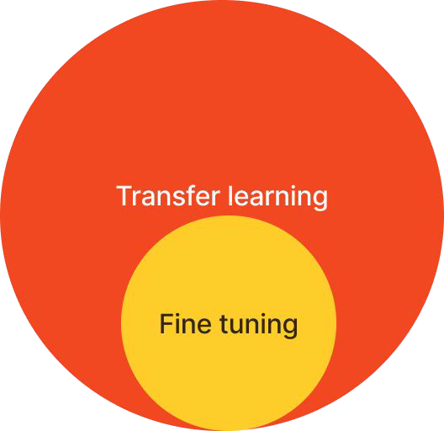
Fine tuning vs. transfer learning
They are often referenced interchangeably
Transfer learning
Apply a general pre-trained model to a new, but related task
Fine tuning
Use a general pre-trained model and then train that model further
Transfer learning ~= ﬁne tuning
Train it more
Train on different data
Source: tensorﬂow.org, interview with Andrej Karpathy and Andrew Ng

Slide 51
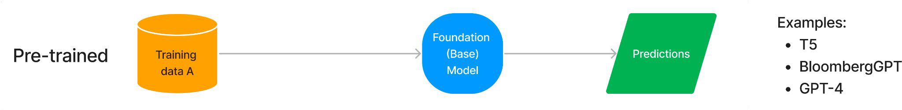
How to leverage a pre-trained foundation model?

Slide 52
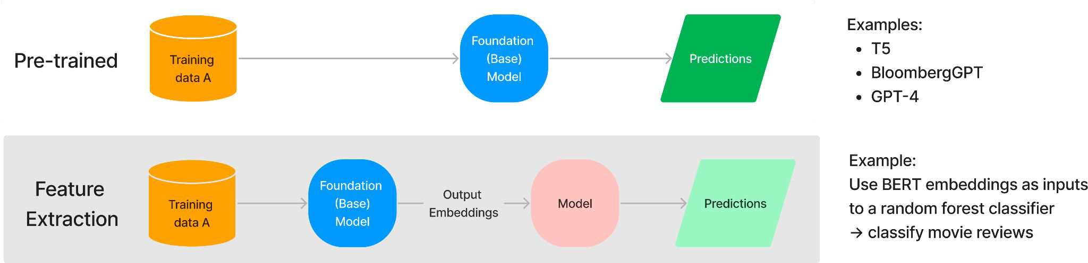
How to leverage a pre-trained foundation model?

Slide 53
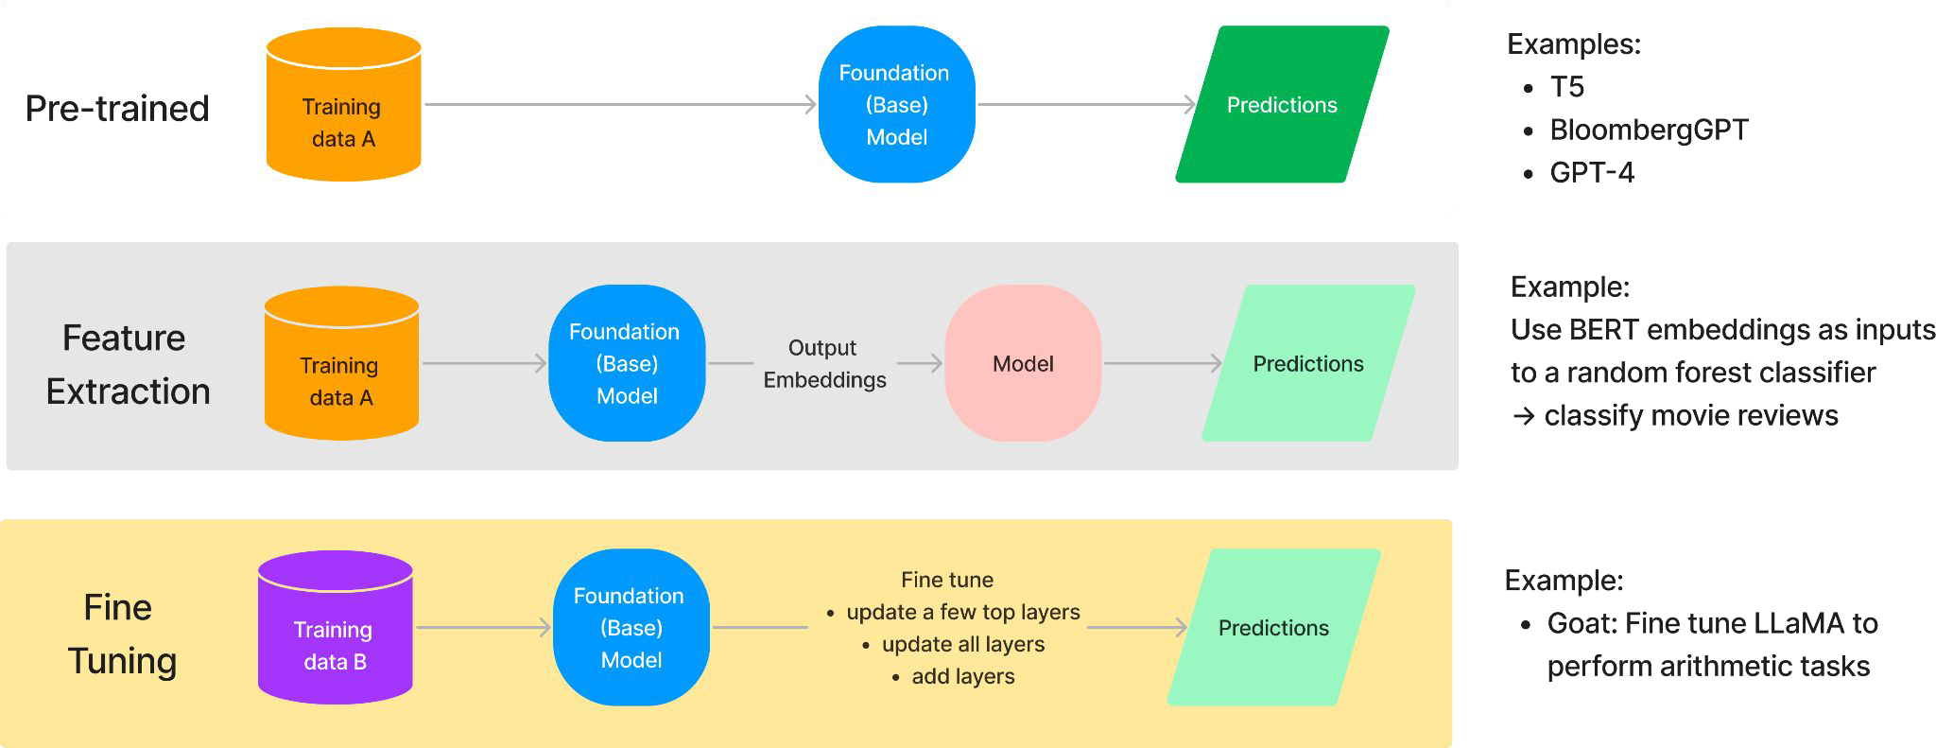
How to leverage a pre-trained foundation model?

Slide 54
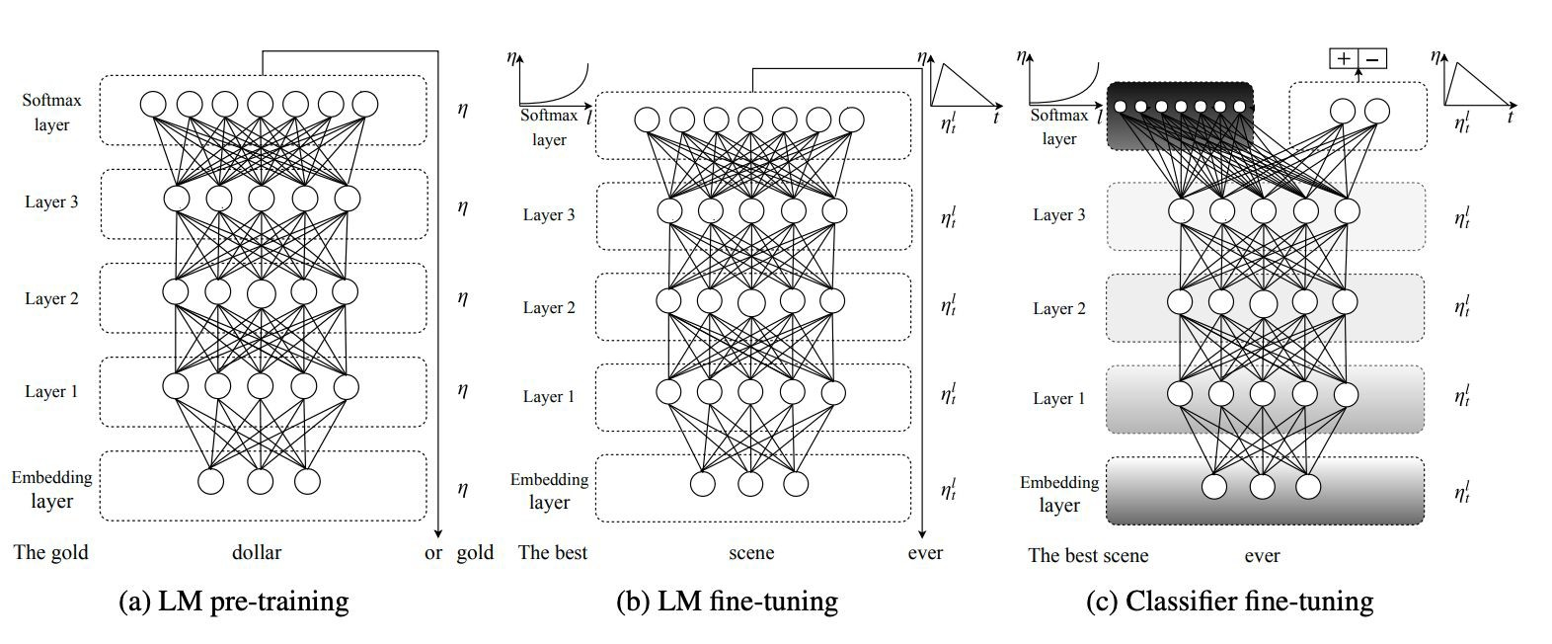
Why ﬁne tuning?
Leverage an effective pre-trained model on our own data – it’s not new
Improve performance downstream
Full
ﬁne-tuning
Fine-tune on
classiﬁer
Different pre-trained vs ﬁne-tuned tasks
Different domains
Ensure regulatory compliance
Not new:
ULMﬁt paper in 2018
Source: Howard and Ruder 2018

Slide 55
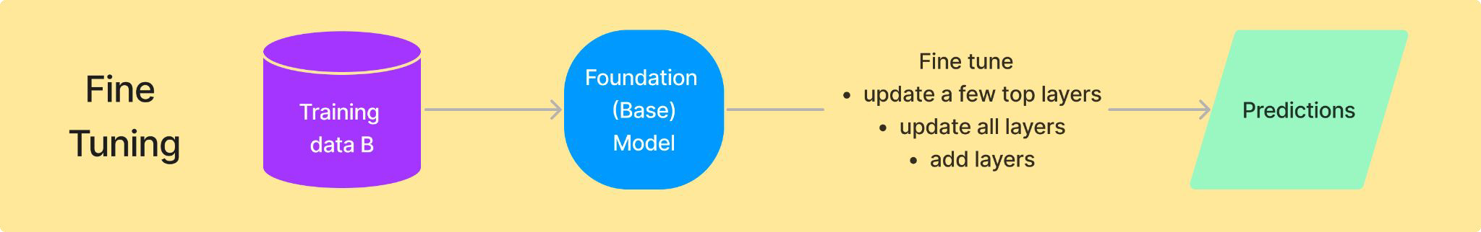
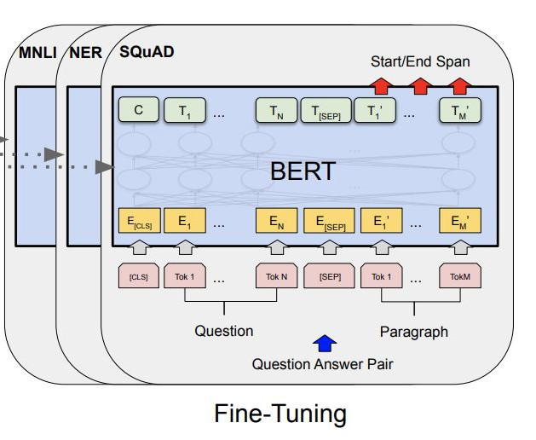
Fine tune = update foundation model weights
AKA parameter ﬁne tuning
Update more layers = better model performance
Full ﬁne-tuning typically produces one model per task
Serve one model per task
May forget other pre-trained tasks: catastrophic forgetting
Full ﬁne-tuning LLMs is expensive. How to avoid it?
X-shot learning
Parameter-efﬁcient ﬁne tuning
Source: Devlin et al 2019

Slide 56

X-shot learning
Provide several examples of new tasks
pipeline(
"""For each tweet, describe its sentiment:
Prompt engineering
= developing prompts
= prompt design
= hard/discrete prompt tuning
Instruction
[Tweet]: "I hate it when my phone battery dies." [Sentiment]: Negative
###
Few-shot examples
[Tweet]: "My day has been [Sentiment]: Positive
###
"
[Tweet]: "This is the link to the article" [Sentiment]: Neutral
###
[Tweet]: "This new music video was incredible" [Sentiment]:""")
Not updating model weights
Prompt

Slide 57
Pros and cons of X-shot learning
Also known as in-context learning
Pros Cons
Manual prompt engineering
Prompts are speciﬁc to models
Context length limitation
No need for huge labeled training data
No need to create a copy of model for each task
Simplify model serving
Text prompts feel interpretable
Add more examples? Less space for instructions
Longer context = higher latency
LLMs forget middle portion
Liu et al 2023 (released in July)
Longer context window is not the solution!
Performance might still be lackluster

Slide 58
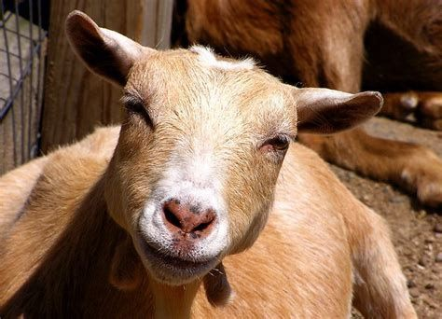
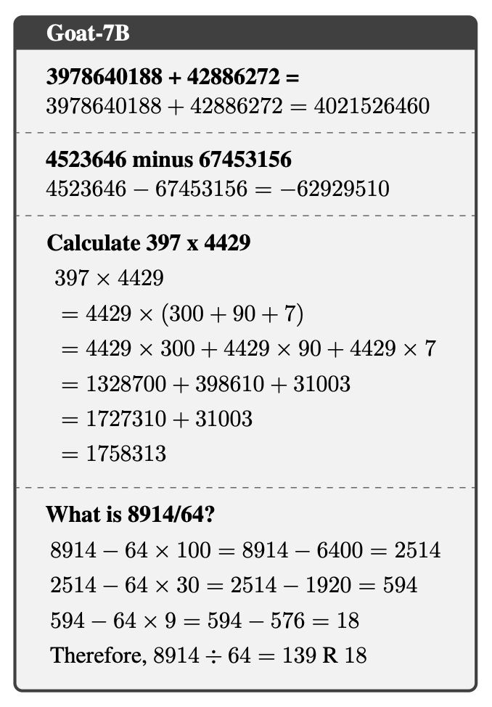
Fine-tuning outperforms X-shot learning
Example: GOod at Arithmetic Tasks (Goat-7B)
Foundation model = Llama
Trained on 1M synthetic data samples
Accuracy outperforms
Image Source
Few-shot PaLM-540B (much bigger model !! )
GPT-4
Typically doesn’t do well in arithmetics; accuracy ~0
SOTA on arithmetic benchmark (BIG-bench)
Supervised instruction ﬁne-tuning
Trained using LoRA on a 24GB VRAM GPU
LoRA to be covered soon!
Source: Liu and Low 2023 (released in May)

Slide 59
Important observations about Goat
Instruction ﬁne-tuned
Multi-task serving
Task 1
Addition
Task 2
Subtraction, using natural language (NL)
Task 3
Multiplication, mix of NL + mathematical symbols
Task 4
Division, mix of NL +
mathematical symbols

Slide 60
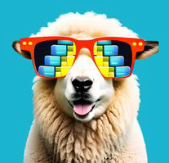
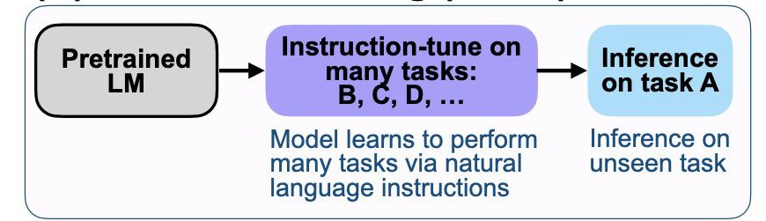
Instruction-tuned, multi-task LLM
Instruction-tuned = tune general purpose LLMs to follow instructions
FLAN (Fine-tuned LAnguage Net) Dolly
Foundation model = 137B model • Foundation model = Pythia-12B
Instruction-tuned on over 60 NLP • datasets with different task types
Task types: Q/A, translation, reasoning, comprehension, etc.
Examples
Instruction-tuned on 15k prompt/response pairs
Task types: Q/A, classiﬁcation, information extraction, etc.
T5 -> FLAN-T5
PaLM -> FLAN-PaLM
Source: Wei et al 2022

Slide 61
Quick recap
We want efﬁcient training, serving, and storage
Full ﬁne-tuning can be computationally prohibitive
Memory usage: activation, optimizer states, gradients, parameters
This gives the best performance
Compromise: Do some, but not full, ﬁne-tuning
Saves cost to use low-memory GPUs
We want multi-task serving, rather than one model per task
E.g. one model for Q/A, summarization, classiﬁcation
•
Enter parameter-efﬁcient ﬁne-tuning

Slide 62
Parameter-efﬁcient ﬁne-tuning (PEFT)

Slide 63
3 categories of PEFT methods
Additive
Selective
Re-parameterization
Soft prompt
Akin to updating a few foundation model layers
Decompose weight matrix updates into smaller-rank matrices
LoRA
Prompt tuning
Preﬁx tuning
BitFit
Only updates bias parameters
Diff Pruning
Creates
task-speciﬁc “diff” vectors and only updates them

Slide 64
We will cover additive and reparameterization
Additive
Soft prompt
Prompt tuning
Preﬁx tuning
Selective
Re-parameterization
Decompose weight matrix into smaller-rank matrices
LoRA
Model quality performance is not as good
Akin to updating a few foundation model layers
BitFit
Only updates bias parameters
DiffPruning
Creates
task-speciﬁc “diff” vectors and only update them
©2023 Databricks Inc. — All rights reserved

Slide 65
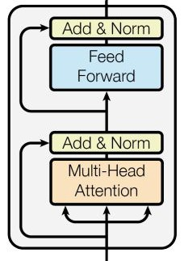
High-level overview of PEFT
Active research area: >100 papers in last few years!
Additive: Add new tunable layers to model
Keep the foundation model weights frozen and update only the new layer weights
Reparameterization: Decompose a weight matrix into lower-rank matrices
Implementation:
Acts on the core Transformer block
Basic multi-head attention and/or feed forward network
Some act speciﬁcally on the weight matrices: Query, Key, Value
These matrices pass information from one token to another
Q
K
V
Source: Vasmani et al 2021

Slide 66
Additive: Prompt Tuning
(and preﬁx tuning)

Slide 67
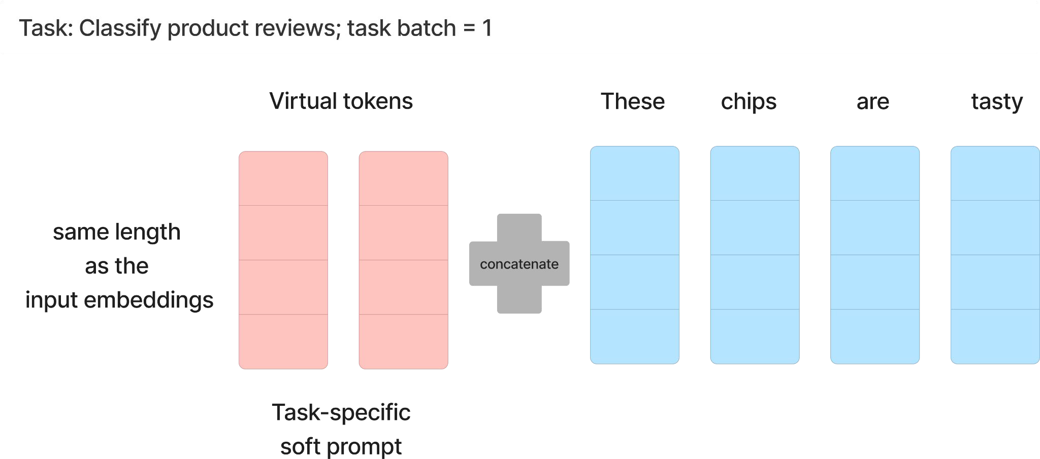
Soft prompt tuning
Concatenates trainable parameters with the input embeddings
Learn a new sequence of task-speciﬁc embeddings
We call this prompt tuning, not model tuning, because we only update prompt weights

Slide 68
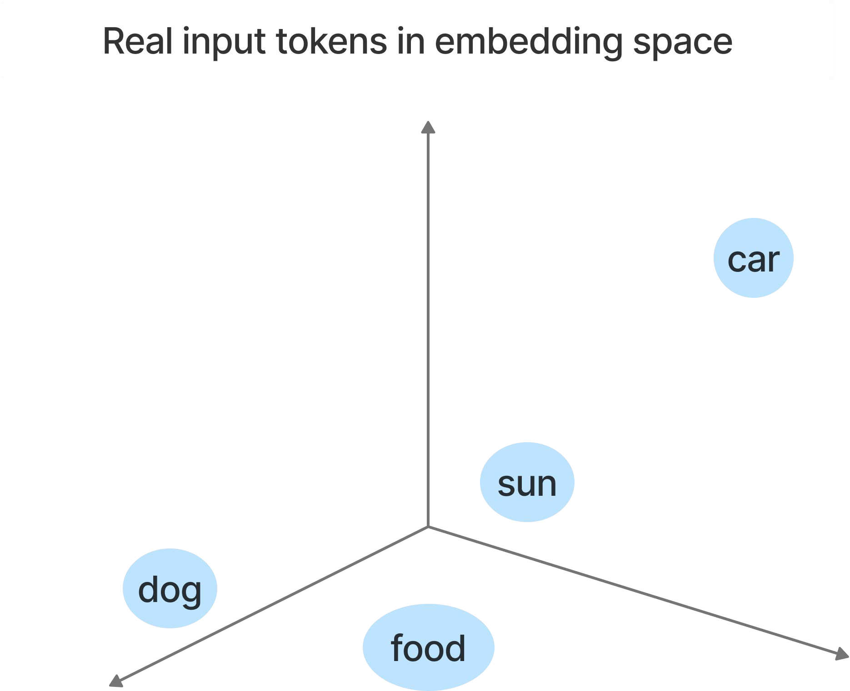
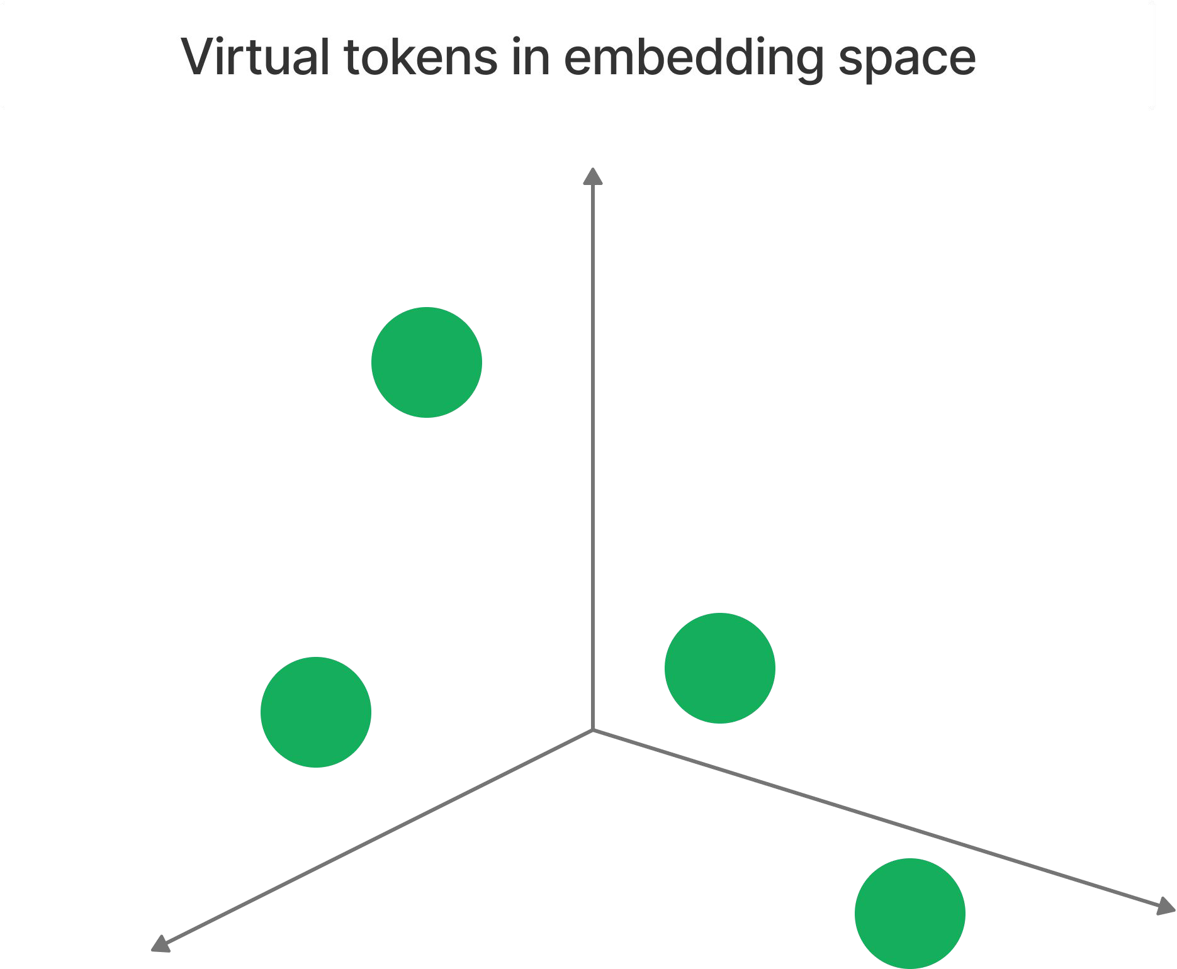
What are these virtual tokens?
Goal: remove manual element of engineering prompts!
Randomly initialized embedding vectors
• We can also initialize to discrete prompts
• But random initialization is nearly as good as informed initialization (Qin and Eisner 2021)
Not part of vocabulary
Analogy:
Bitcoin: We can’t touch it like cash. We don’t know how it “looks”, but it exists and works.

Slide 69
What are these virtual tokens?
Goal: remove manual element of engineering prompts!
Randomly initialized embedding vectors
We can also initialize to discrete prompts
But random initialization is nearly as good as informed initialization (Qin and Eisner 2021)
Not part of vocabulary
Analogy:
Bitcoin: We can’t touch it like cash. We don’t know how it “looks”, but it exists and works.

Slide 70
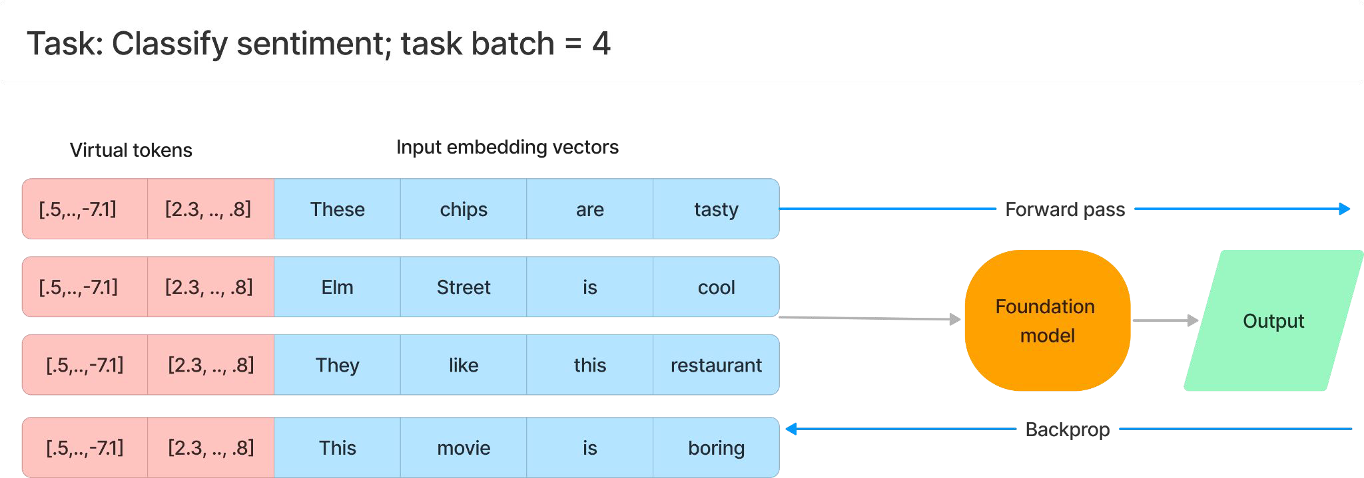

Compare full ﬁne-tuning vs prompt tuning
Scenario: full ﬁne-tuning
Backprop: update all weights based on loss

Slide 71

Compare full ﬁne-tuning vs prompt tuning
Scenario: prompt tuning
Backprop: update only prompt weights based on loss
The model learns the optimal representation of the prompt automatically

Slide 72
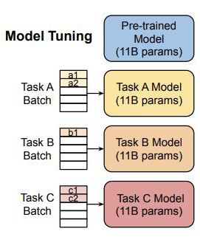
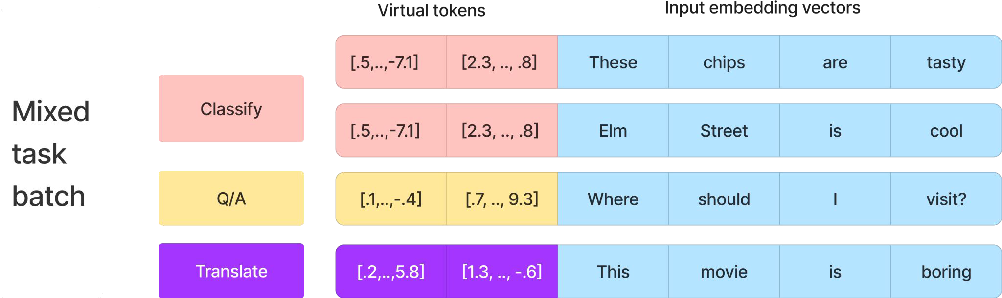
Allows swapping of task prompts
Efﬁcient for multi-task serving
Each task is a prompt, not a model
Only need to serve a single copy of the frozen model for multi-task serving
Prompts for various tasks can be applied to different inputs
A serving request can be a single, larger mixed task batch
Source: Lester et al 2021

Slide 73
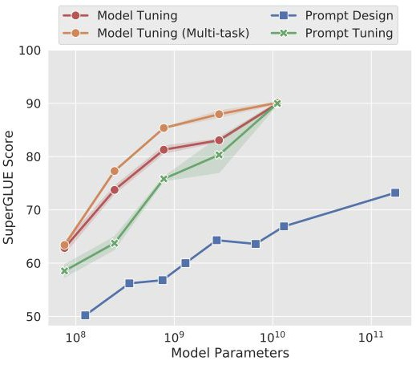
Matches ﬁne tuning performance for >11B model
Comparable with full ﬁne-tuning at the 10B model scale
Performance
gap with small model
More applicable to larger models
SuperGLUE (2019)
Styled after GLUE, but more difﬁcult and diverse
Boolean questions, comprehension, etc.
Source: Lester et al 2021

Slide 74
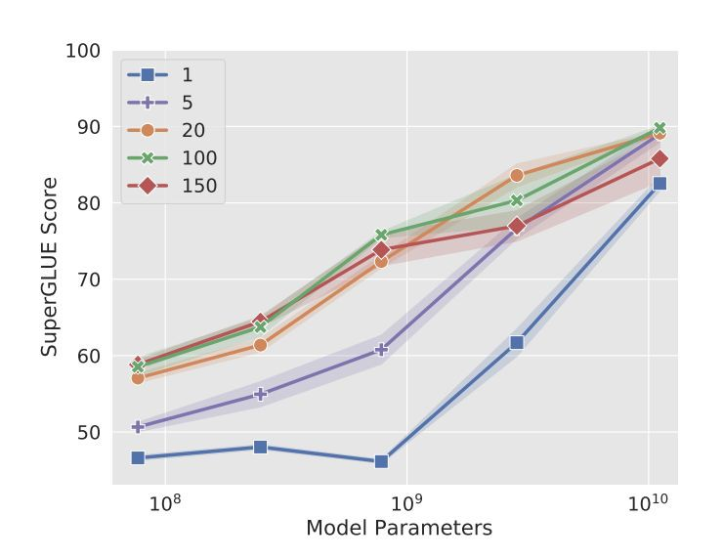
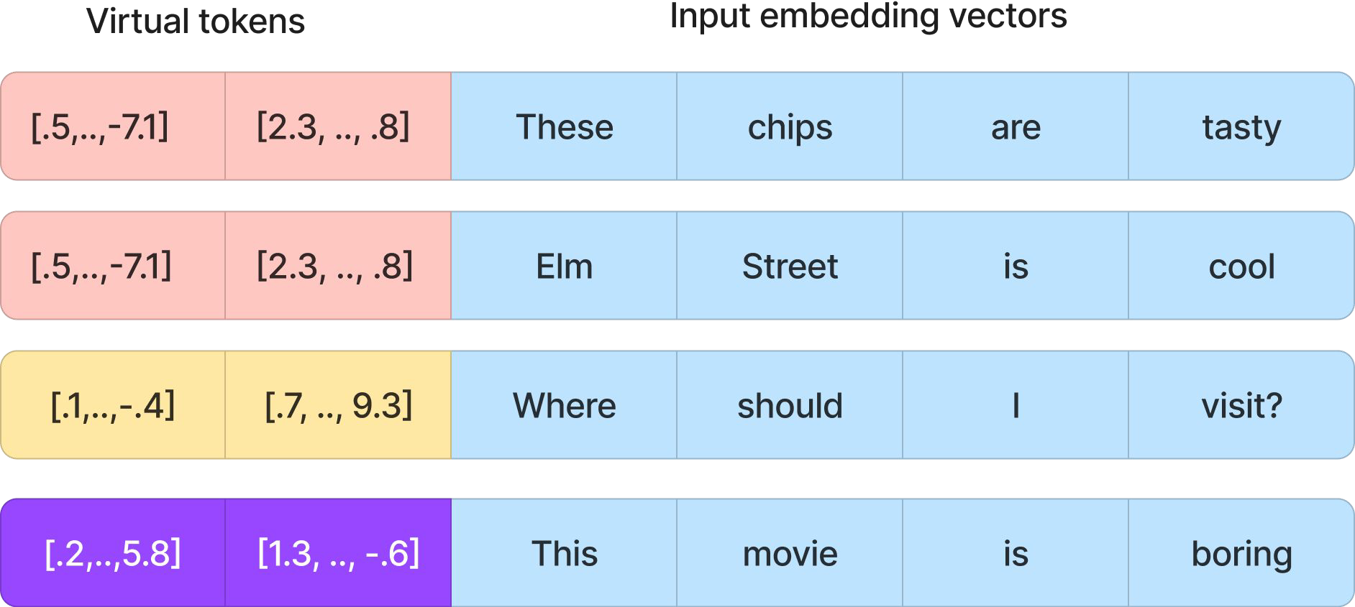
Prompt length affects larger models less
Prompt length of 20-100 is typical
In this example:
(Virtual) prompt length = 2
Instability
Larger
models do ﬁne with prompt length of 1
Source: Lester et al 2021

Slide 75
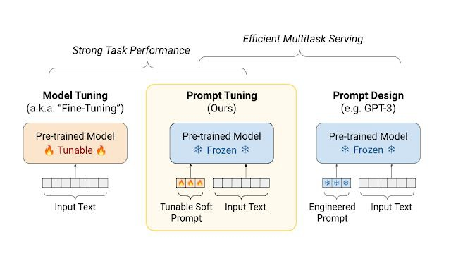
Advantages of prompt tuning
Use whole training set
Not limited by # of examples that can ﬁt in the context
Automatically learn a new prompt for a new model
Backprop helps us ﬁnd the best representation
One foundation model copy only
Source: Google AI Blog
Resilient to domain shift

Slide 76
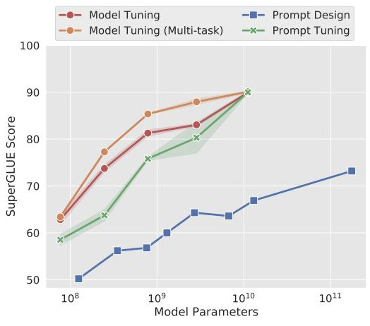
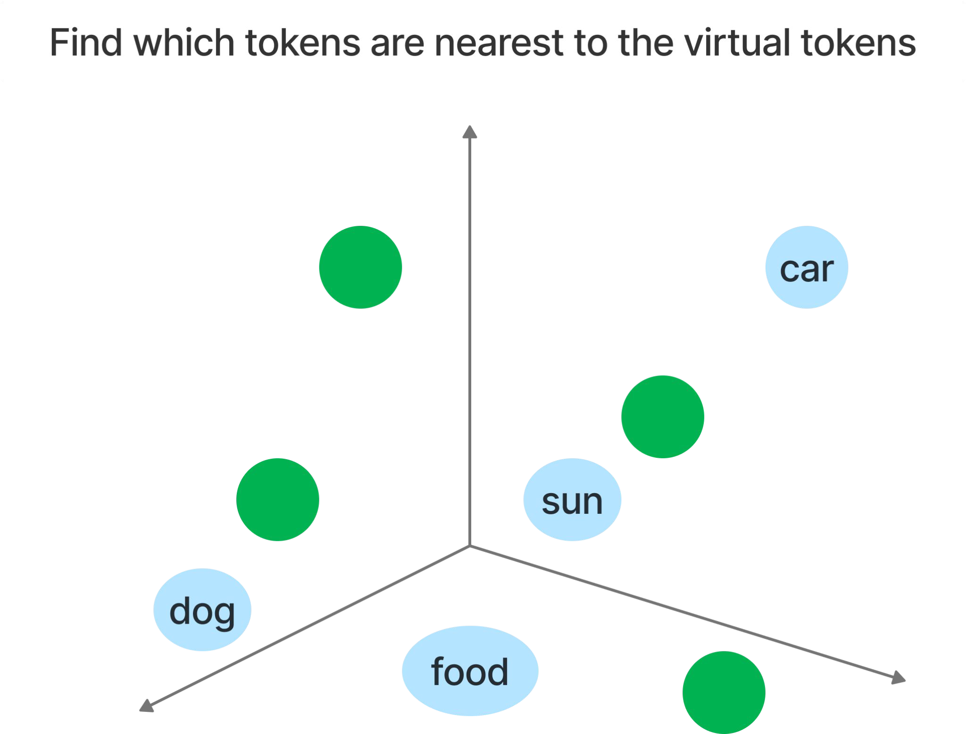
Disadvantages of prompt tuning
Less interpretable
Unstable performance
Need to convert the embeddings back to tokens
Use cosine distance to ﬁnd the top-K nearest neighbors
Instability
Source: Lester et al 2021

Slide 77
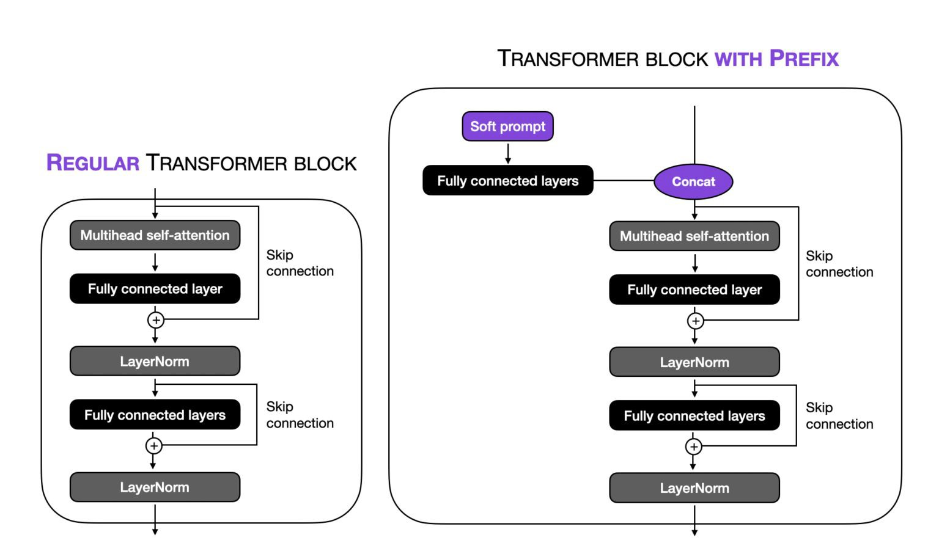

Preﬁx tuning is very similar to prompt tuning
Adding tunable layer to each transformer block, rather than just the input layer
Source: Li and Liang 2021
Source: Lightning AI

Slide 78
Re-parameterization: LoRA

Slide 79

Low-Rank Adaptation (LoRA)
Decomposes the weight change matrix into lower-rank matrices

Slide 80

Low-Rank Adaptation (LoRA)
Decomposes the weight change matrix into lower-rank matrices

Slide 81

Rank? Brief visit to linear algebra
Maximum # of linearly independent columns or rows
How many unique rows or columns?
Full rank = no redundant row or column in the matrix
Linear = can multiply by a constant
Independence = no dependence on each other
Row rank: 1
2nd row = 3x 1st row
Column rank: 1
2nd column = 2x 1st column
3rd column = 2x 2nd column

Slide 82


How does weight matrix decomposition work?
Observation: Actual rank of the attention weight matrices is low
^{W}delta ^{= W}a ^{+ W}b
Total parameters = (100 x 2) + (2 x 100) = 400
Original parameters = (100 x 100) = 10,000 parameters
Reduction = 10,000 - 400 = 96%!

Slide 83

LoRA matches/~outperforms full ﬁne-tuning
37.7 / 175255.8
= 0.0002
= 0.02% of parameters!
Rouge
Source: Hu et al 2021

Slide 84

LoRA performs well with very small ranks
GPT-3’s validation accuracies are similar across rank sizes
W_{q} = query W_{k} = key W_{v} = value
W_{o} = output
Source: Hu et al 2021
But, small r likely won’t work for all tasks/datasets.
E.g. downstream task is in a different language

Slide 85

Advantages of LoRA
Similar to prompt tuning, majority of the model weights are frozen
Able to share and re-use the foundation model
Swap different LoRA weights for serving different tasks
Improves training efﬁciency
Lower hardware barrier (no need to calculate most gradients or optimizer states)
Adds no additional serving latency
W_a * W_b can be merged
Can be combined with other PEFT methods

Slide 86
Limitations of LoRA
Not straightforward to do multi-task serving
How to swap different combos of A and B in a single forward pass?
If dynamically choose A and B based on tasks, there is additional serving latency
Future research
From LoRA authors: If W_{delta} is rank-deﬁcient, is W too?
Newer PEFT technique: IA3 (2022)
Reduces even more trainable parameters than LoRA!

Slide 87
PEFT Limitations

Slide 88
Model performance limitations
Difﬁcult to match the performance of full ﬁne-tuning
Sensitive to hyperparameters
Unstable performance
Current research area: where is best to apply PEFT?
E.g. why apply PEFT to only attention weight matrices? Soft prompts?
Vu et al 2022: Soft prompt transfer
We may still need full-parameter ﬁne-tuning
Lv et al 2023 (released in June): use new optimizer, LOMO, to reduce memory usage to ~11%

Slide 89



Compute limitations
Doesn’t reduce time complexity of training
Requires full forward and backward passes
Doesn’t reduce the cost of storing massive foundation models
Doesn’t always make
inference more efﬁcient

Slide 90
Data Preparation Best Practices

Slide 91


Better models from better training data
Many newer good models use C4 (e.g. MPT-7B)
Llama GPT-Neo and GPT-J
Trained on the Pile: 22 diverse datasets
Outperformed GPT-3 in some instances (Read more here)
Trained on 20 most-spoken languages, focusing on those with Latin and Cyrillic alphabets
Colossal
Cleaned Crawled Corpus
Source: Touvron et al 2023
©2023 Databricks Inc. — All rights reserved
Source: Gao et al 2020

Slide 92

Training data makes the biggest difference
Not necessarily the model architecture
Bloomberg created 363B-token dataset of English ﬁnancial documents spanning 40 years
Augmented with 345B-token public dataset
Outperforms existing open models on ﬁnancial tasks
Source: Wu et al 2023

Slide 93
How much ﬁne-tuning data do I need?
Zhou et al 2023 (May): ﬁne-tune 1,000 high-quality labeled examples from LLaMa 65B
When scaling up data quantity, need to scale up prompt diversity
OpenAI: At least a couple hundred
Doubling dataset size leads to linear increase in model performance
How to get more data? Synthetic data
Synonym replacement / rewrite
Word deletion: “brilliantly expressed” => “expressed”
Word position swapping: “It is lovely” -> “Lovely, it is”
Noise injection: introduce typos

Slide 94


Data preparation best practices
Quantity, diversity, and quality
Don’t provide detailed instructions. Only prompt and completion.
Fixed separator \n\n###\n\n to inform when the prompt ends and completion begins
The separator shouldn’t appear anywhere else
Source: OpenAI
Source: Zhou et al 2023

Slide 95
Data preparation best practices
Remove undesired data
Offensive, toxic content
Private or conﬁdential information
Using LLM output as data is not always the answer
Imitation models learn style, rather than content (Gudibande et al 2023)
Consistent with Zhou et al 2023: knowledge is largely learned during pre-training
Manually verify data quality

Slide 96
Module Summary
Efﬁcient Fine-Tuning - What have we learned?
Fine-tuning gives the best results, but can be computationally expensive
Parameter-efﬁcient ﬁne-tuning reduces # of trainable parameters
Prompt tuning allows virtual prompts to be learned automatically
LoRA decomposes the weight change matrix into lower-rank matrices
Fine-tuning data quality and diversity matters a lot

Slide 97
Time for some code!

Slide 98
Course Outline
Course Introduction
Module 1 - Transformers: Attention and the Transformer Architecture Module 2 - Parameter Efﬁcient Fine-Tuning: Doing more with less Module 3 - Deployment Optimizations: Improving model size and speed Module 4 - Multi-modal LLMs: Beyond text-based transformers

Slide 99
Module 3
Deployment Optimizations
Improving model size and speed

Slide 100
Learning Objectives
By the end of this module you will:
Be able to make the design choices for your LLM development
Create and design your own pseudo Mixture-of-Experts LLM system
Develop an understanding of the utility of quantization in LLMs for both training and inferencing

Slide 101
Extra-Large Language Models
What if our models are too big?

Slide 102

The issue with high performance LLMs
Paying the price for quality
As models grow in size, they get “better” and “worse”.
Better - accuracy, alignment, abilities
Worse - speed, memory footprint, updatability
small fast low quality model
Large…slow...high...quality…model.
What if we could improve the speed and footprint while preserving quality?

Slide 103
Improving Learning Efﬁciency
How can we train and ﬁne-tune better?

Slide 104


How we interact with LLMs
The importance of context length
LLMs, like us, do better at tasks with more context.
This means longer input/context length.
Computing input embeddings
Performing FFNN calculations
Calculating attention scores
linearly linearly quadratically
Even worse:
Attention cannot perform as well on longer context than it was trained on.
Source: ALiBi

Slide 105



Training short but inference long
You’ll need a good Alibi for this one
Attention is all you need… to ﬁx! And just with a linear bias.
Source: ALiBi

Slide 106


Faster calculations
Calculating attention in a ﬂash.
Observation:
Fastest memory in the GPU is SRAM
Longer context = larger attention matrices
Problem:
SRAM is small relative to the attention matrix needed in calculations
Solution: Flash Attention!
Attention compute operations are redone, no matrix created!
More time spent in SRAM, massive performance boost
Source: Flash Attention

Slide 107


Many queries, fewer keys
Multi-query and Grouped-query Attention
Multi-Headed Attention
#Queries = #Keys = #Values
Each head can focus on different parts of language.
Inference - slow, accurate.
Multi-Query Attention Many Queries, 1 Key, 1 Value
Forcing the model to use different queries
Inference - fast, inaccurate.
Grouped-Query Attention #Queries = #/n Keys = #/n Values Inference - fast, accurate.
Source: Grouped Query Attention

Slide 108
Improving Model Footprint
Doing more with less

Slide 109




Storing numbers
Billions of parameters. Each a ﬂoating point number.
FP16 FP32 - IEEE standards.
Google Brain saw this and created the BF16
Same range as FP32
Same size as FP16
What if we need to go even further?
Source: Google bﬂoat16

Slide 110


Quantization
Do we need so much precision?
Approximate the values in quantized forms
Create quantized functions
©2023 Databricks Inc. — All rights reserved
Source: LLM.int8()

Slide 111

QLoRA
Applying quantization to ﬁne tuning
LoRA was already great!
QLoRA adds even more:
4-bit quantization
Paged optimization
Source: QLoRA

Slide 112
Multi-LLM Inferencing
Hybrid and Ensemble-based systems

Slide 113


Mixture-of-Experts
A trillion parameters, for a fraction of the training
Mixture-of-Experts (MoE):
Input is sent to a router
Multiple NNs are trained
Switch Transformer:
Application of MoE
Position-wise FFNN are multiplied
Single attention network
Source: Switch Transformer

Slide 114

LLM Cascades and FrugalGPT
Improving our resource allocation in LLM inferencing
LLM cascade:
Send prompts to smallest models
Gather conﬁdence of response
If too small, move to a larger model
Source: FrugalGPT

Slide 115
Current Best Practices
If you want to build now, do it right

Slide 116


Best Practices
Training from scratch:
ALiBi
Flash Attention
Grouped-Query Attention
Mixture-of-Experts
Fine-tuning/Inferencing:
LoRA/QLoRA
FrugalGPT
©2023 Databricks Inc. — All rights reserved
Source: LLM-Numbers

Slide 117
Module Summary
Deployment Optimizations - What have we learned?
LLMs are currently outpacing modern compute capacity, necessitating the development of work around solutions and approaches
Modifying the original approach to attention has allowed for longer contexts, better use of hardware, more efﬁcient calculations
Quantization helps to store and use massive LLMs on smaller hardware
Combing LLM inferences of different models allows an effective scale up of parameters with minimal cost changes

Slide 118
Time for some code!

Slide 119
Course Outline
Course Introduction
Module 1 - Transformers: Attention and the Transformer Architecture Module 2 - Parameter Efﬁcient Fine-Tuning: Doing more with less Module 3 - Deployment Optimizations: Improving model size and speed Module 4 - Multi-modal LLMs: Beyond text-based transformers

Slide 120
Module 4
Multi-modal Language Models (MLLMs)
Beyond text-based transformers

Slide 121
Learning Objectives
By the end of this module you will:
Survey the broad landscape of multi-modality that leverages LLMs
Understand how transformers accept non-text inputs, e.g. images and audio
Examine how multi-modal data is procured
Discuss limitations of multi-modal LLMs and alternative architectures to transformers
Identify the wide possibilities of multi-modal applications

Slide 122



Going beyond uni-modality
LLM-based models that can receive and reason with multimodal info
Source: Yin et al 2023 (released in late June)
Source: OpenAI

Slide 123





Multi-modality mirrors how we perceive info
More user-friendly, ﬂexible, and capable
Source: Zhu et al 2023
Source: Zhang et al 2023
Demo for Video LLaMA

Slide 124



Chain-of-Thought MLLMs
We can also supply multi-modal information as “in-context”
Source: Zhang et al 2023
Source: Himakunthala et al 2023

Slide 125



MLLMs can process multi-modalities simultaneously
Source: Su et al 2023 (released in May)
PandaGPT Demo

Slide 126




MLLMs also call tools/models to ﬁnish tasks
HuggingGPT Demo

Slide 127
Transformers beyond text
One architecture to rule them all

Slide 128





















Transformer: a general sequence processing tool
We can treat many things as a sequence
1 | 2 | 3 | 4
5 | 6 | 7 | 8
Music notes; image source
Audio; image source
Images
Video frames; image source
©2023 Databricks Inc. — All rights reserved
Protein; image source
Game actions; image source

Slide 129
Cross attention bridges between modalities
Allows different modalities to inﬂuence each other
Modality A
Self attention
Modality B
Self attention
Cross attention
A and B could be:
Images, audio, text, time series, or any sequence! Example:
Stable Diffusion uses cross attention to bridge between text and images

Slide 130
Computer vision

Slide 131
Well-researched area
We need to ﬁrst understand how to represent images as numbers
Zero-shot learning
Few-shot learning
Vision Transformer (ViT), 2021
Swin Transformer, 2021
CLIP, 2021
VisualGPT, 2022
Flamingo, 2023
GPT-3, 2020
SimVLM, preﬁx LM for image/text, 2022
MLP-Mixer, 2021; not transformer nor CNNs

Slide 132


We chop an image up into small pixels
A colored image is made up of Red, Blue, Green (RBG) levels
Each pixel range = (0, 256)
Source: KDNuggets

Slide 133


Colored images are 3-D tensors
Grayscale images are 2-D tensors: all 3 channels have the same value
Width
Height
Scalar
0-D tensor
Vector
1-D tensor
Matrix
2-D tensor
Channel
3-D tensor
Adapted from TowardDataScience and KDNuggets

Slide 134


Initial idea: Turn pixels into a sequence
Use self-attention to predict the next pixel, instead of word token
Limitations:
Lose vertical spatial relationships
Source: Chen et al 2021

Slide 135

Initial idea: Turn pixels into a sequence
Use self-attention to predict the next pixel, instead of word token
Limitations:
Lose vertical spatial relationships
Memory and computational requirements scale quadratically to sequence length, O(N²)
Source: Chen et al 2021
Source: David Coccomini 2021

Slide 136

Vision Transformer (ViT)
Computes attention on patches of images: image-to-patch embeddings

Slide 137
Vision Transformer (ViT)
Computes attention on patches of images: image-to-patch embeddings
16
One pixel
16
One patch

Slide 138
ViT: An image is worth 16x16 words
N input patches with shape of
3 x Pixel (P) x P
©2023 Databricks Inc. — All rights reserved
……

Slide 139
Linear project each patch to D-dimensional vector
N input patches with shape of
3 x Pixel (P) x P
©2023 Databricks Inc. — All rights reserved
……

Slide 140
 |  | D-dim patch embedding
……
Linear project each patch to D-dimensional vector
N input patches with shape of
3 x Pixel (P) x P
©2023 Databricks Inc. — All rights reserved
……

Slide 141
 | D-dim patch embedding
 | D-dim learned positional embedding
1
2
3
4
5
6
7
8
……
16
14
15
Add positional embedding
Linear project each patch to D-dimensional vector
N input patches with shape of
3 x Pixel (P) x P
©2023 Databricks Inc. — All rights reserved
……

Slide 142
 | D-dim patch embedding
 | D-dim learned positional embedding
1
2
3
4
5
6
7
8
……
16
CLS
14
15
Add positional embedding | Special classiﬁcation token,
Linear project each patch to D-dimensional vector | D-dim | learned
N input patches with shape of
3 x Pixel (P) x P
©2023 Databricks Inc. — All rights reserved
……

Slide 143
Original Transformer
 | D-dim patch embedding
 | D-dim learned positional embedding
1
2
3
4
5
6
8
……
16
CLS
7
14
15
Add positional embedding
Special classiﬁcation token,
D-dim learned
Linear project each patch to D-dimensional vector
N input patches with shape of
3 x Pixel (P) x P
©2023 Databricks Inc. — All rights reserved
……

Slide 144
C-dim classiﬁer output vector, where C= # classes
……
Original Transformer
 | D-dim patch embedding
 | D-dim learned positional embedding
1
2
3
4
5
6
8
……
16
CLS
7
14
15
Add positional embedding
Special classiﬁcation token,
D-dim learned
Linear project each patch to D-dimensional vector
N input patches with shape of
3 x Pixel (P) x P
©2023 Databricks Inc. — All rights reserved
……

Slide 145
Label = “cat”
C-dim classiﬁer output vector, where C= # classes
……
Original Transformer
 | D-dim patch embedding
 | D-dim learned positional embedding
1
2
3
4
5
6
8
……
16
CLS
7
14
15
Add positional embedding
Special classiﬁcation token,
D-dim learned
Linear project each patch to D-dimensional vector
N input patches with shape of
3 x Pixel (P) x P
©2023 Databricks Inc. — All rights reserved
……

Slide 146

ViT only outperforms ResNets on larger datasets
More computationally efﬁcient than ResNet
ViT is ~4 times faster than ResNet to train
ViT is worse
ViT outperforms
ResNet
Source: Dosovitsky et al 2021

Slide 147
Many other vision-text models
Not necessarily revolutionary, but an evolution in computer vision research
Zero-shot learning
Few-shot learning
Vision Transformer (ViT), 2021
Swin Transformer, 2021
CLIP, 2021
VisualGPT, 2022
Flamingo, 2023
GPT-3
SimVLM, preﬁx LM for image/text, 2022
MLP-Mixer, 2021; not transformer nor CNNs
Inspires many other
follow-ups!

Slide 148
Audio

Slide 149


Audio signals are 2-dim spectrograms
We create embedding vectors for each t-min audio frame
Embedding for each
audio frame
Frequency
Frequency
Time
Time = Length of audio
= # of columns in the matrix

Slide 150

Audio is usually much longer than text length
Need to apply convolution layers with large strides to reduce dimensions
Speech Transformer (2018)
Encoder-decoder Transformer
Extract features using different optional modules: ResCNN, ResCNNLSTM,e tc.

Slide 151

Few multi-modal advances
Also much harder: emotion, acoustics, tone, speed, speaker identiﬁcation
Most models focus on only text-speech, speech-text, or speech-speech
Data2vec (MetaAI, 2022)
Self-supervised algorithm for speech, vision, and text
The only one so far?
Source: Mehrish et al 2023

Slide 152
Training Data for MLLMs

Slide 153



Hand-crafted training data
Text-audio or text-video data is much harder to procure
Source: WebVid
Source: VideoChat
Source: Himakunthala et al 2023

Slide 154


Instruction-tuned, hand-crafted data
Source: CC-3M
Source: LLaVa

Slide 155


Instruction-tuned, model-generated data
Actually: manually design examples ﬁrst, then ask model to generate more
Source: Liu et al 2023

Slide 156

LAION-5B: open source image-text data
Original data: Common Crawl; ﬁltered with OpenAI’s CLIP model
Disclaimer:
Contains mostly copyrighted images. LAION doesn’t claim ownership.
Source: LAION

Slide 157
X-shot learning for MLLMs

Slide 158
Computer Vision

Slide 159
X-shot learning to the rescue?
Gathering multi-modal data is harder than just images or text data
Zero-shot learning
Few-shot learning
Vision Transformer (ViT), 2021
Swin Transformer, 2021
CLIP, 2021
VisualGPT, 2022
Flamingo, 2023
GPT-3
SimVLM, preﬁx LM for image/text, 2022
MLP-Mixer, 2021; not transformer nor CNNs
Inspires many other
follow-ups!

Slide 160


Zero-shot: Contrastive Language-Image Pairing
CLIP predicts which image-text pair actually occurs in the training data
Collects 400M image-text pairs from the internet as training data
At test time
Predict the probability of
each caption
Source: OpenAI

Slide 161

CLIP performs better across settings
Big limitation:
Inﬂexible
Cannot generate text
CLIP performs much better in
non-ImageNet settings
Source: OpenAI
©2023 Databricks Inc. — All rights reserved

Slide 162


Few-shot, in-context: Flamingo
Uniﬁes treatment of high-dimensional video and image inputs
Architecture highlight 3:
Interleave cross-attention
with language-only self-attention
layers
Architecture highlight 2: Perceiver resampler
Architecture highlight 1:
Allows interleaved multi-modal inputs
Source: Alayrac et al 2022

Slide 163


Flamingo bridges vision and language models
Vision encoder similar to CLIP + Chinchilla (Language) accept interleaved inputs
Source: Alayrac et al 2022
Image source: Samuel Albanie

Slide 164

Perceiver resampler outputs ﬁxed-sized
tokens
5 output tokens
Maps variable-size
grid of inputs to a ﬁxed number of output tokens
Query
Keys and values
= spatio-temporal visual features
Temporal embeddings
Variable-sized inputs
Source: Alayrac et al 2022

Slide 165

Outperforms 6 out of 16 SOTA ﬁne-tuned models
Curated 3 high-quality datasets: LTIP (Long Text-Image Pairs), VTP (Video-Text Pairs), and MultiModal Massive Web (M3W)
Source: Alayrac et al 2022

Slide 166



Qualitative inspection on selected samples
Supported input format: (image, text) or (video, text) + visual query
Source: Alayrac et al 2022

Slide 167
Audio

Slide 168

Zero-shot: OpenAI’s Whisper
Encoder-decoder transformer: splits input audio into 30-second frames
Spectrogram
Source: Radford et al 2022

Slide 169

Whisper matches human robustness
Without ﬁne-tuning on benchmark data
WER = word error rate
LibriSpeech
1K hours of read English speech

Slide 170
Challenges
We haven’t ﬁgured it all out yet

Slide 171




MLLMs are not immune from LLM limitations
They inherit LLM risks
Hallucination
Prompt sensitivity
Context limit
Inference compute cost
Bias, toxicity, etc.
Copyrights issues
Source: Alayrac et al 2022 (Flamingo)
Source: laion.ai
Source: New York Times, April 2023
Source: Next Shark, X Post

Slide 172


MLLMs can lack common sense (like LLMs)
Source: Thrush et al 2022 Tested on many models, including CLIP and VisualBERT
Source: Ramesh et al 2022 Used CLIP and DALLE-2; Prompt: “a red cube on top of a blue cube”
GPT-3 completion
Input: You poured yourself a glass of cranberry, but then absentmindedly, you poured about a teaspoon of grape juice into it. It looks OK. You try snifﬁng it, but you have a bad cold, so you can’t smell anything. You are very thirsty. So you
Completion: drink it. You are now dead.
Source: Robust AI and NYU

Slide 173
Attention may not be forever
What may remain or rise?

Slide 174

Reinforcement learning with human feedback
Human feedback trains the reward model (LM). KL loss ensures minimal divergence from the original LLM. Proximal Policy Optimization (PPO) updates the LLM.
Source: Ahead of AI on Substack

Slide 175



Hyena Hierarchy
Convolutional neural networks are making a comeback?
Good few-shot learners for languages
Matches performances of Vision Transformers (ViT)
Source: Poli et al 2023

Slide 176


Retentive Networks
A new attention variant: a retention mechanism to connect recurrence and attention, without compromising performance
Source: Sun et al 2023 (released in July)

Slide 177
Emerging applications
It’s a great time to be alive

Slide 178

DreamFusion
Generates 3D objects from text caption
Source: Poole et al 2022

Slide 179

Make-a-Video
Generates video from text: “Cat watching TV with a remote in hand”
Source: Singer et al 2022

Slide 180

PaLM-E-bot
Robotics application: “bring me the rice chips from the drawer”
Source: Driess et al 2023

Slide 181

AlphaCode: generate code
Problem: Minimum # of minutes to makes pizzas of N slices
Source: Li et al 2022

Slide 182


Multi-lingual models: Bactrian-X
An instruction-following model
Prompt:
“It’s an apocalypse. Describe how you survive and make allies”
Lower-resource languages
Source: Li et al 2023 (GitHub and Paper); released in May

Slide 183

Gato: a generalist AI agent
Can play Atari, caption images, chat, stack blocks with a real robot arm
Source: Reed et al 2022

Slide 184

Textless NLP
Generate speech from raw audio without text transcription
Helps with low-resource languages
Click here for demo on Meta AI

Slide 185

AlphaFold
Uses attention to predict protein folding
Source: Google DeepMind and Timeline of Breakthrough

Slide 186
Module Summary
Multi-modal LLMs - What have we learned?
MLLMs are gaining traction
Transformers are general sequence-processing architectures that can accept non-text sequences
MLLMs inherit limitations from LLMs
Transformers may not be the last architecture standing
More exciting and unimaginable MLLM applications are on the horizon

Slide 187
Time for some code!

